Slide 1
Gaussian Processes
Scientific Machine Learning
Sebastian Klein

Slide 2
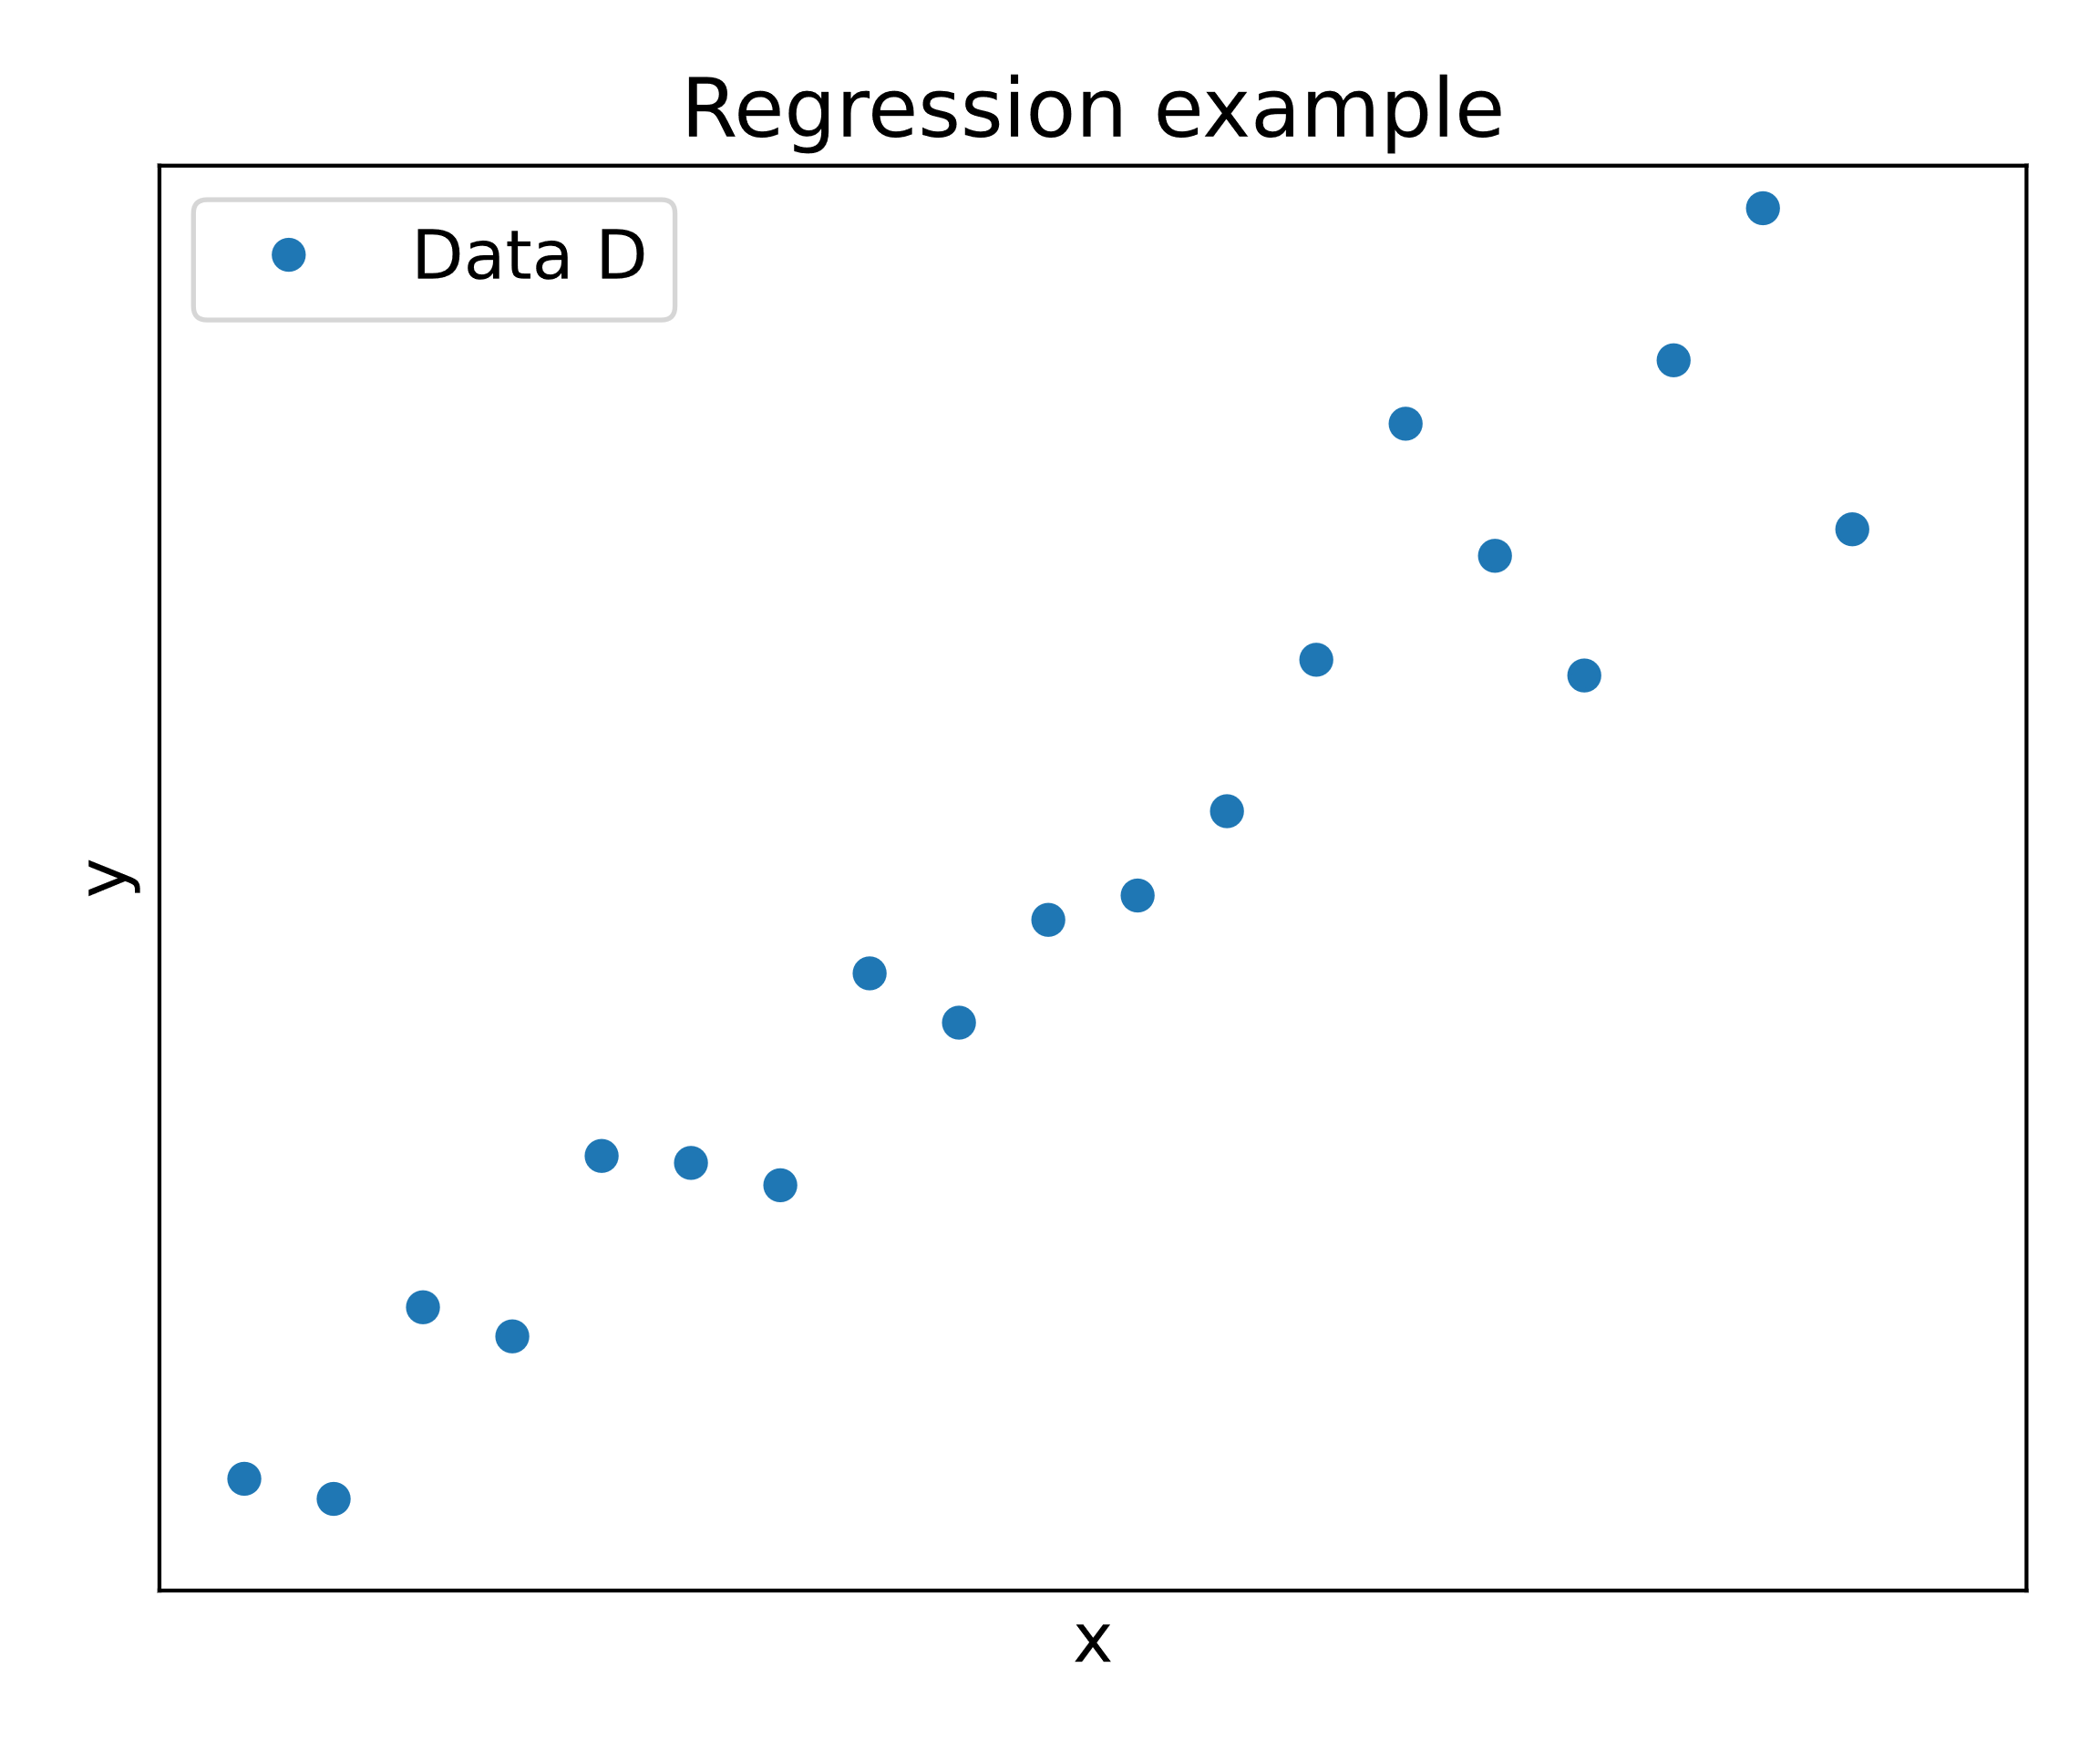
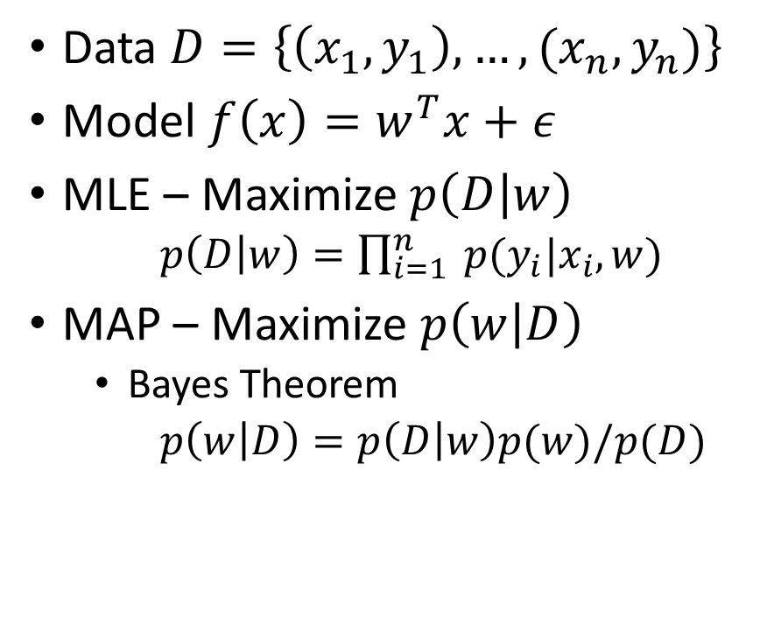
Motivation – Regression problems [1]
Data $D=\left\{\left(x_{1},y_{1}\right),…,(x_{n},y_{n})\right\}$
Model $f\left(x\right)=w^{T}x+ε$
MLE – Maximize$p\left(D | w\right)$
$p\left(D | w\right)=\prod_{i=1}^{n}{ p(y_{i}|x_{i}, w)}$
MAP – Maximize $p\left(w | D\right)$
Bayes Theorem
$p\left(w | D\right)=p\left(D | w\right)p(w)/p(D)$
Notes:
$w^{T}x+ε$ – epsilon = noise, w - model parameters
$p(y_{i}|x_{i}, w$) how likely is it that the x_i gives rise to the y_i with the parameter w
MLE - Maximum Likelihood Estimation - max probability of Data $p\left(D | w\right)$ for a parameter $w$
MAP- Maximum a posteriori

Slide 3
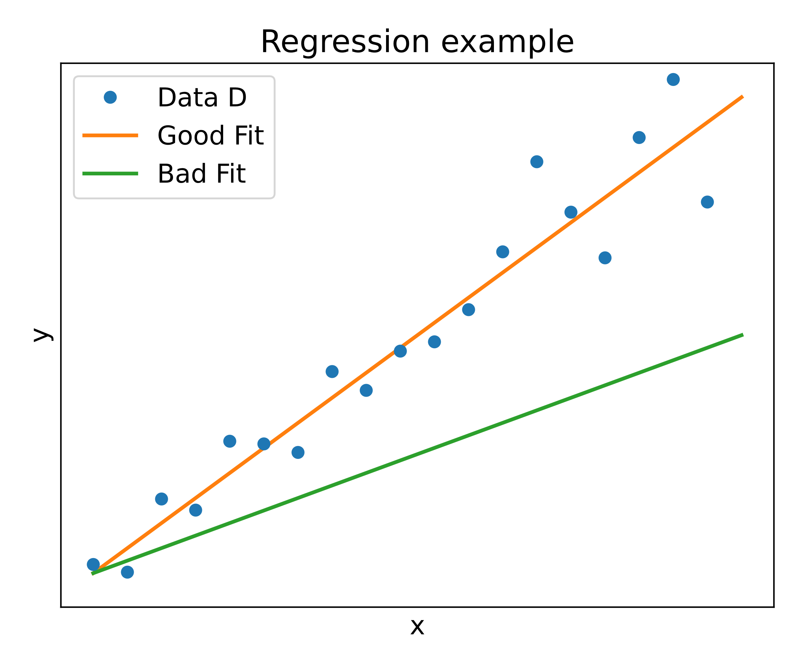
Motivation – Regression problems [1]
Data $D=\left\{\left(x_{1},y_{1}\right),…,(x_{n},y_{n})\right\}$
Model $f\left(x\right)=w^{T}x+ε$
MLE – Maximize$p\left(D | w\right)$
$p\left(D | w\right)=\prod_{i=1}^{n}{ p(y_{i}|x_{i}, w)}$
MAP – Maximize $p\left(w | D\right)$
Bayes Theorem
$p\left(w | D\right)=p\left(D | w\right)p(w)/p(D)$
Notes:
$w^{T}x+ε$ – epsilon = noise, w - model parameters
$p(y_{i}|x_{i}, w$) how likely is it that the x_i gives rise to the y_i with the parameter w
MLE - Maximum Likelihood Estimation - max probability of Data $p\left(D | w\right)$ for a parameter $w$
MAP- Maximum a posteriori

Slide 4
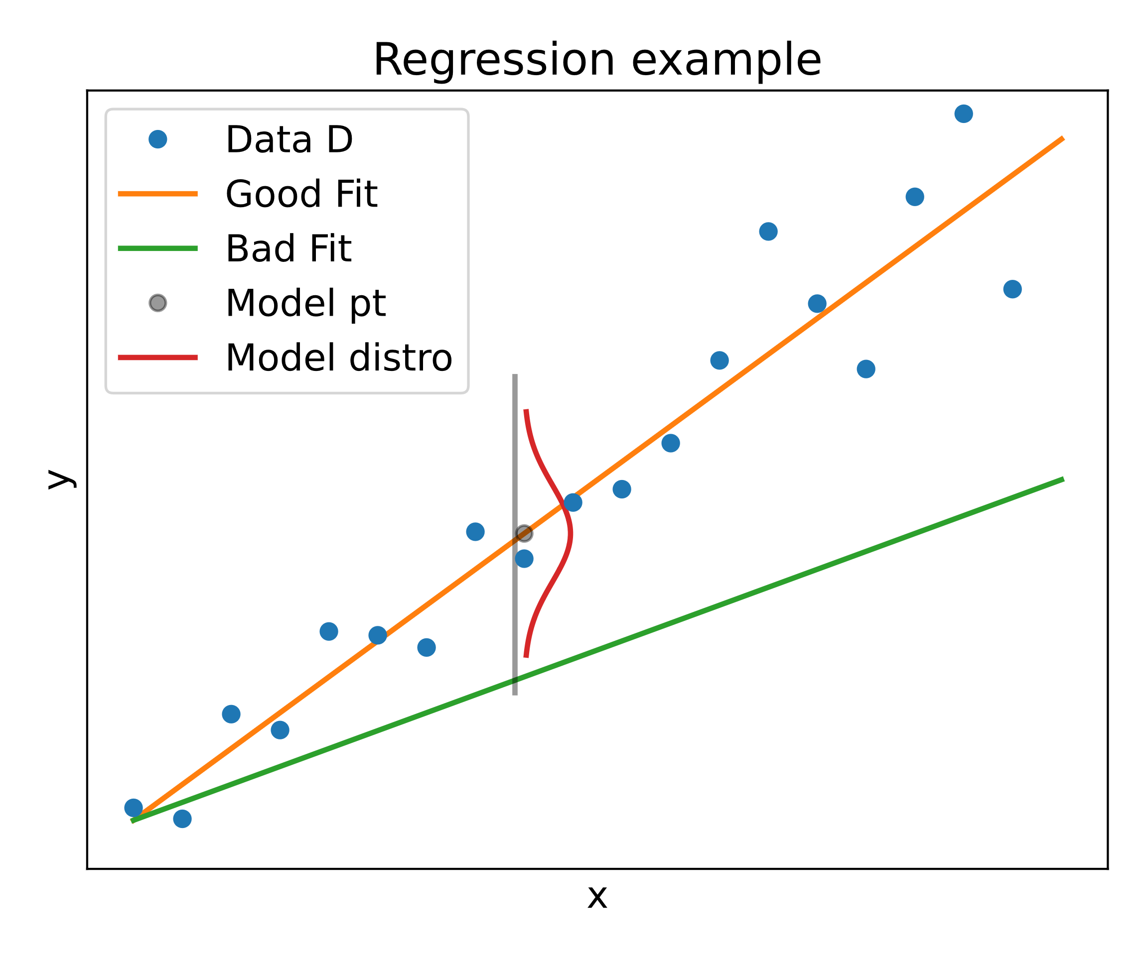
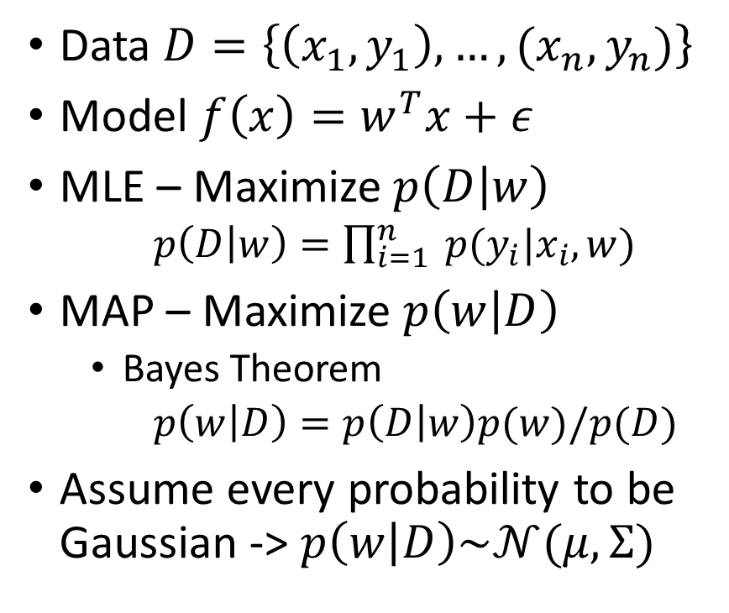
Motivation – Regression problems [1]
Data $D=\left\{\left(x_{1},y_{1}\right),…,(x_{n},y_{n})\right\}$
Model $f\left(x\right)=w^{T}x+ε$
MLE – Maximize$p\left(D | w\right)$
$p\left(D | w\right)=\prod_{i=1}^{n}{ p(y_{i}|x_{i}, w)}$
MAP – Maximize $p\left(w | D\right)$
Bayes Theorem
$p\left(w | D\right)=p\left(D | w\right)p(w)/p(D)$
Assume every probability to be Gaussian -> $p\left(w | D\right)\sim 𝒩(μ, Σ)$
Notes:
$w^{T}x+ε$ – epsilon = noise, w - model parameters
$p(y_{i}|x_{i}, w$) how likely is it that the x_i gives rise to the y_i with the parameter w
MLE - Maximum Likelihood Estimation - max probability of Data $p\left(D | w\right)$ for a parameter $w$
MAP- Maximum a posteriori
Assume Gaussian probability in MLE -> p
Last line -> How do we come to the conclusion $p\left(w | D\right)\sim 𝒩(μ, Σ)$

Slide 5
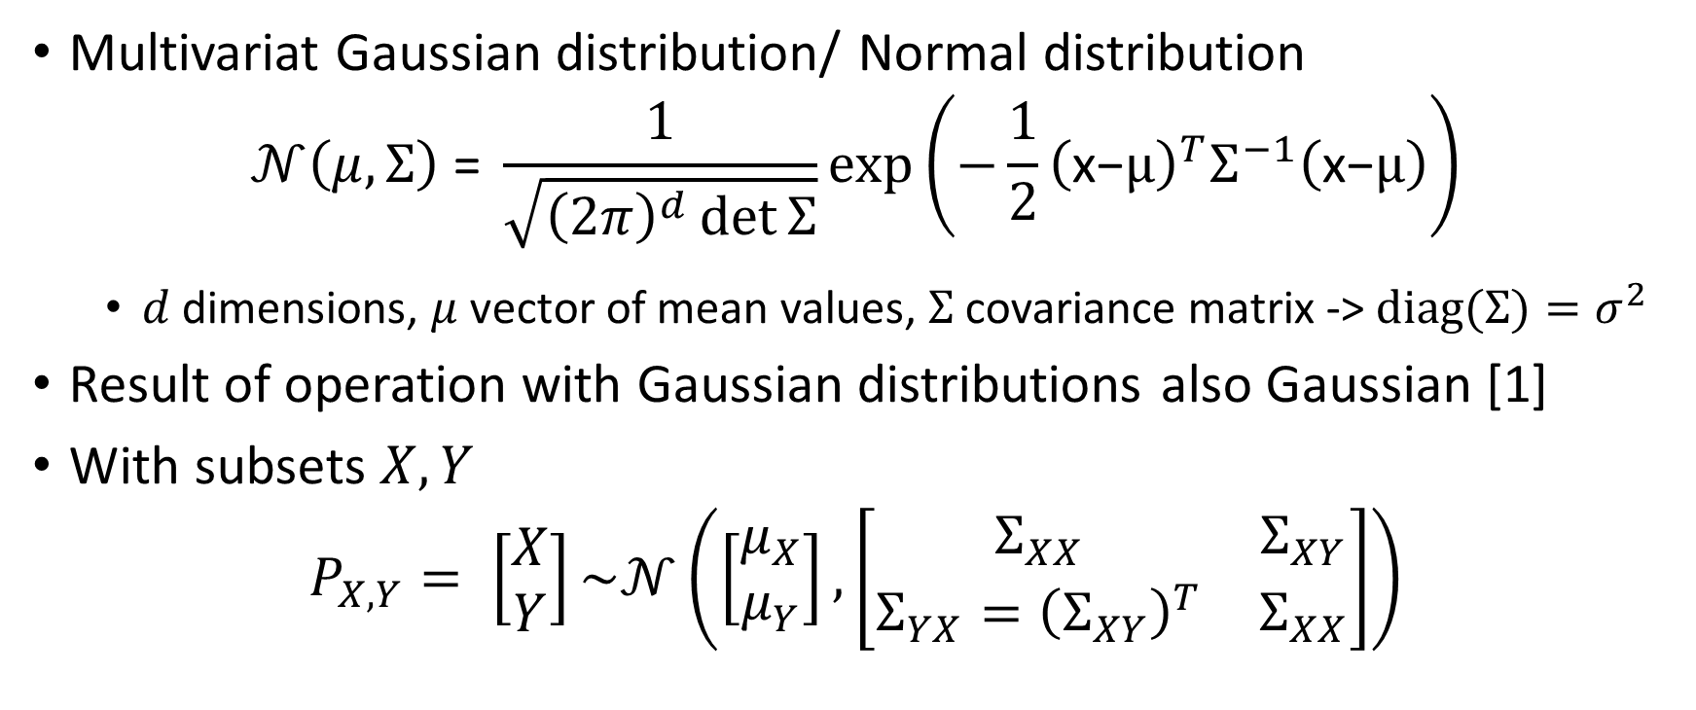
Intermezzo – Multivariate Gaussian[2]
Multivariat Gaussian distribution/ Normal distribution
$$𝒩\left(μ, Σ\right) \text{=} \frac{1}{\sqrt{{\left(2π\right)}^{d}\det{Σ}}}\text{exp}\left(−\frac{1}{2}{\left(\text{x}\text{−}μ\right)}^{T}Σ^{−1}\left(\text{x}\text{−}μ\right)\right)$$
$d$ dimensions, $μ$ vector of mean values, $Σ$ covariance matrix -> $diag(Σ)=σ^{2}$
Result of operation with Gaussian distributions also Gaussian [1]
With subsets $X,Y$
$$P_{X,Y}= \left[\begin{matrix}X \\ Y\end{matrix}\right]\sim 𝒩\left(\left[\begin{matrix}μ_{X} \\ μ_{Y}\end{matrix}\right],\left[\begin{matrix}Σ_{XX} & Σ_{XY} \\ Σ_{YX}={\left(Σ_{XY}\right)}^{T} & Σ_{XX}\end{matrix}\right]\right)$$
Notes:
$σ^{2}$ is the variance
$σ$ is the standard deviation
Marginalization and Conditioning operating on subsets

Slide 6
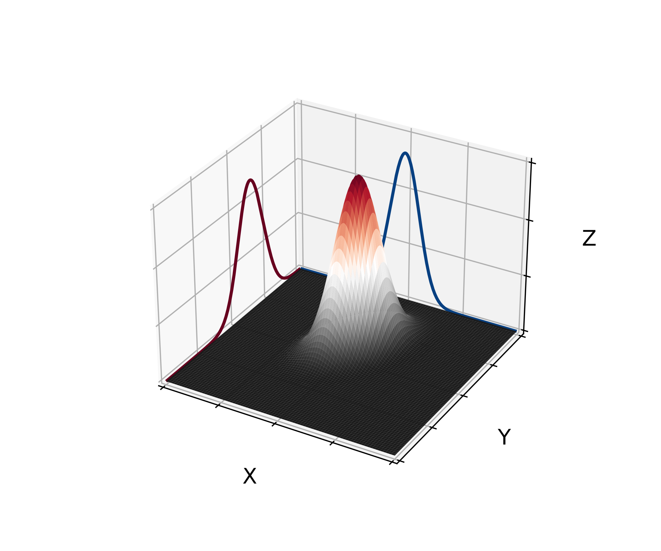
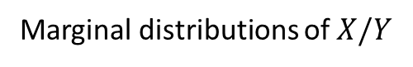
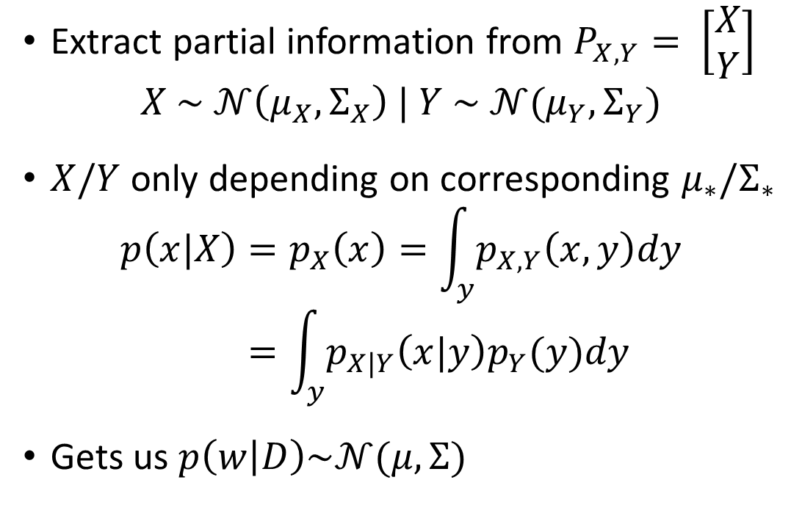
Intermezzo – Marginalization [2]
Extract partial information from $P_{X,Y}= \left[\begin{matrix}X \\ Y\end{matrix}\right]$
$$X \sim 𝒩\left(μ_{X},Σ_{X}\right) | Y \sim 𝒩(μ_{Y},Σ_{Y})$$
$X/Y$only depending on corresponding $μ_{∗}/Σ_{∗}$
$$p\left(x|X\right)=p_{X}\left(x\right)=\int_{y}{p_{X,Y}\left(x,y\right)dy} \\ =\int_{y}{p_{X|Y}\left(x|y\right)p_{Y}(y)dy}$$
Gets us $p\left(w | D\right)\sim 𝒩(μ, Σ)$
Marginal distributions of $X/Y$
Notes:
Marginalization tells us that the posterior distributioin p(w|D) is also gaussian distributed with some mean and some covariance matrix

Slide 7
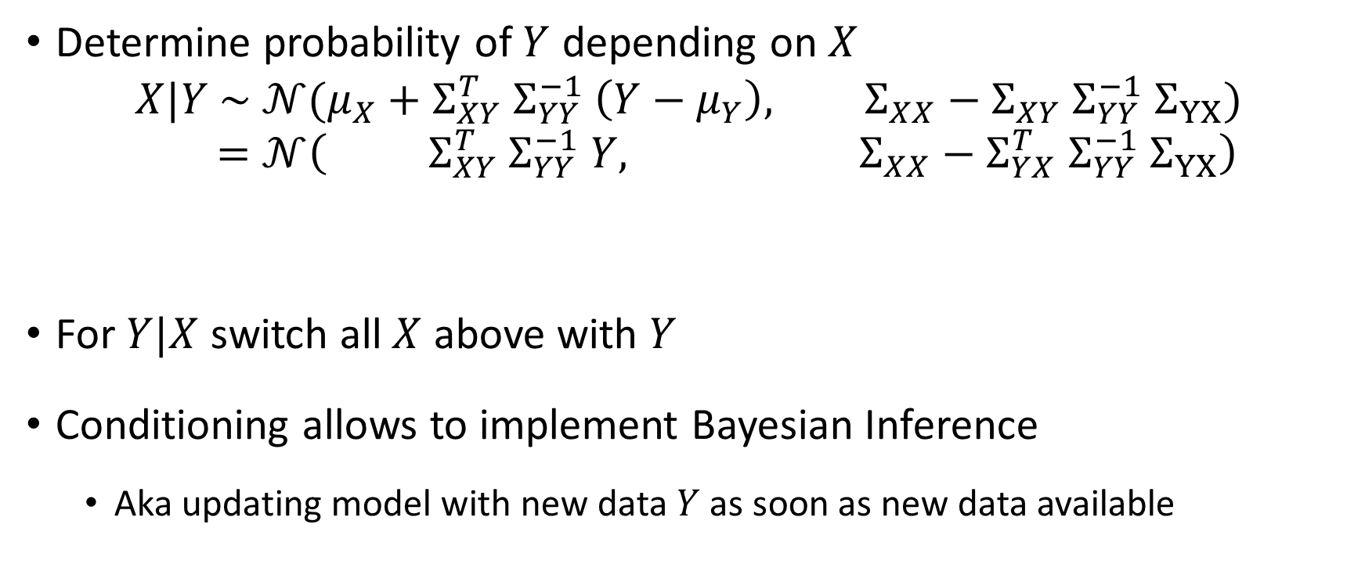
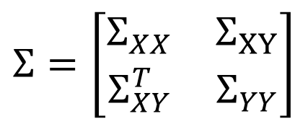
Intermezzo – Conditioning [2]
Determine probability of $Y$ depending on $X$
$$X|Y \sim 𝒩(μ_{X}+Σ_{XY}^{T} Σ_{YY}^{−1} \left(Y−μ_{Y}\right), Σ_{XX}−Σ_{XY} Σ_{YY}^{−1} Σ_{YX}) \\ =𝒩\left( Σ_{XY}^{T} Σ_{YY}^{−1} Y, Σ_{XX}−Σ_{YX}^{T} Σ_{YY}^{−1} Σ_{YX}\right)$$
For $Y|X$ switch all $X$ above with $Y$
Conditioning allows to implement Bayesian Inference
Aka updating model with new data $Y$ as soon as new data available
Mean
Covariance Matrix
$$Σ=\left[\begin{matrix}Σ_{XX} & Σ_{XY} \\ Σ_{XY}^{T} & Σ_{YY}\end{matrix}\right]$$
Notes:
(or vice versa) conditioning
Cornerstone of GP
Last line assume $μ_{Y}=0$

Slide 8
Regression as Gaussian Process (GP) [2]
How to predict values?
Know $p\left(w | D\right) \sim 𝒩(μ, Σ)$
Know 𝑝(𝑤│𝐷) ~ 𝒩(𝜇, Σ)
What is a prediction here?
Sample drawn from $𝒩\left(μ, Σ\right)$
Sample drawn from 𝒩(𝜇, Σ)
How get $𝒩(μ, Σ)$?
How get 𝒩(𝜇, Σ)?
Learn with training data $Y$
Learn with training data 𝑌
Predict value for test data $X$
Predict value for test data 𝑋
How to determine $μ$ and $Σ$?
How to determine 𝜇 and Σ?
Set $μ=0$
Set 𝜇=0
Simplifies conditioning to $X|Y \sim 𝒩\left(0, Σ_{XX}−Σ_{YX}^{T} Σ_{YY}^{−1} Σ_{YX}\right)$
Simplifies conditioning to 𝑋|Y ~𝒩(0, Σ_𝑋𝑋−Σ_𝑌𝑋^𝑇 Σ_𝑌𝑌^(−1) Σ_YX )
Characteristic of $𝒩(μ, Σ)$ determined solely by $Σ$
Characteristic of 𝒩(𝜇, Σ) determined solely by Σ
Notes:
Later we can add back $μ≠0$

Slide 9
Regression as Gaussian Process [2]
Last result
How to determine the $Σ$’s?
How to determine the Σ’s?
$Σ=Cov\left(X,X^{′}\right)$ with $Cov\left(X,X^{′}\right)=k\left(x,x^{′}\right)$
Σ=𝐶𝑜𝑣(𝑋,𝑋^′ ) with 𝐶𝑜𝑣(𝑋,𝑋^′ )=𝑘(𝑥,𝑥^′ )
Evaluate $k\left(x,x^{′}\right)$ pairwise
Evaluate 𝑘(𝑥,𝑥^′ ) pairwise
Covariance function $k\left(x,x^{′}\right)$ also called kernel
Covariance function 𝑘(𝑥,𝑥^′ ) also called kernel
Can choose any kernel that is
Positive semidefinite
+
Symmetric
Combinations possible
$$𝒩\left(0, Σ_{XX}−Σ_{YX}^{T} Σ_{YY}^{−1} Σ_{YX}\right)$$
𝒩(0, Σ_𝑋𝑋−Σ_𝑌𝑋^𝑇 Σ_𝑌𝑌^(−1) Σ_YX )
Notes:
covariance function
as long as symmetry and pos. semidefinite combine

Slide 10
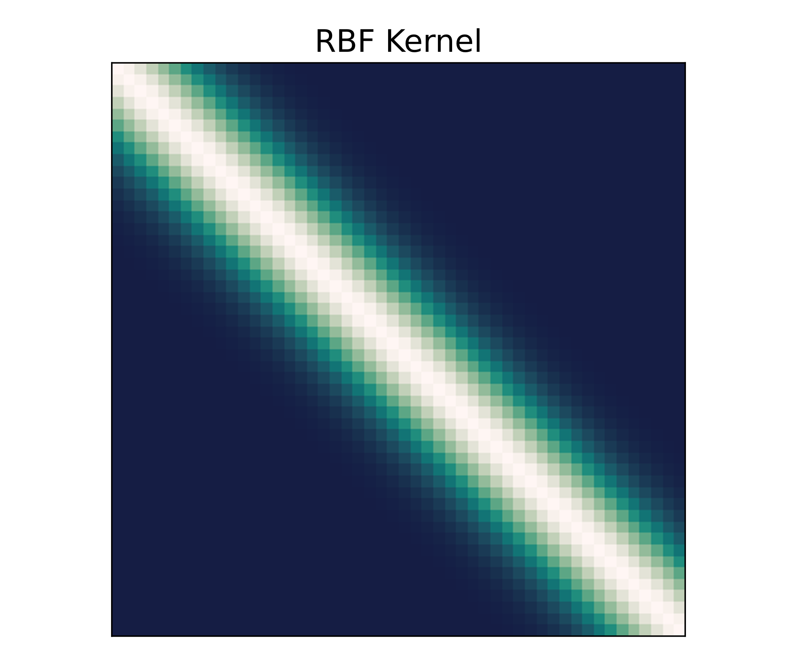
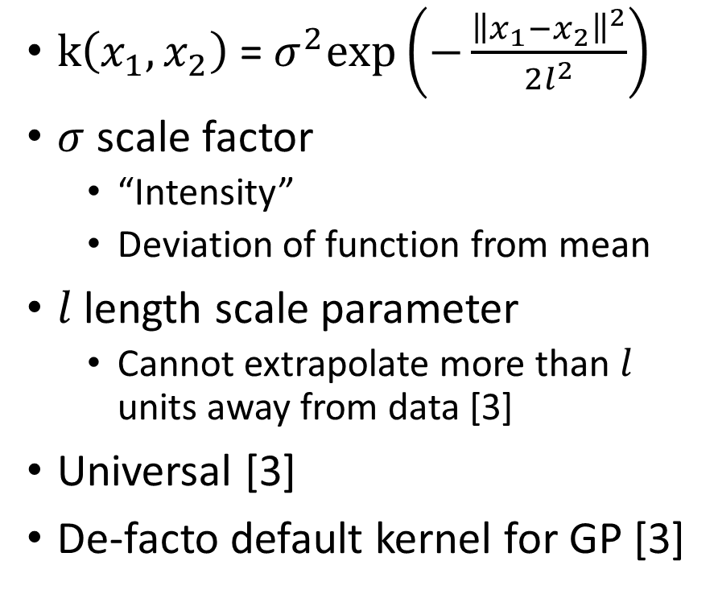
Kernels – RBF [2]
$\text{k}\left(x_{1},x_{2}\right) \text{=} σ^{2}\text{exp}\left(−\frac{{\left\|x_{1}−x_{2}\right\|}^{2}}{2l^{2}}\right)$
$σ$ scale factor
“Intensity”
Deviation of function from mean
$l$ length scale parameter
Cannot extrapolate more than $l$ units away from data [3]
Universal [3]
De-facto default kernel for GP [3]
Notes:
$σ$ and l are hyper parameters that one neets to choose, alter also hyperparameters
Difference in compact support or infinit – compact support ownly in lengthscale l meaniningfull prediction possible

Slide 11
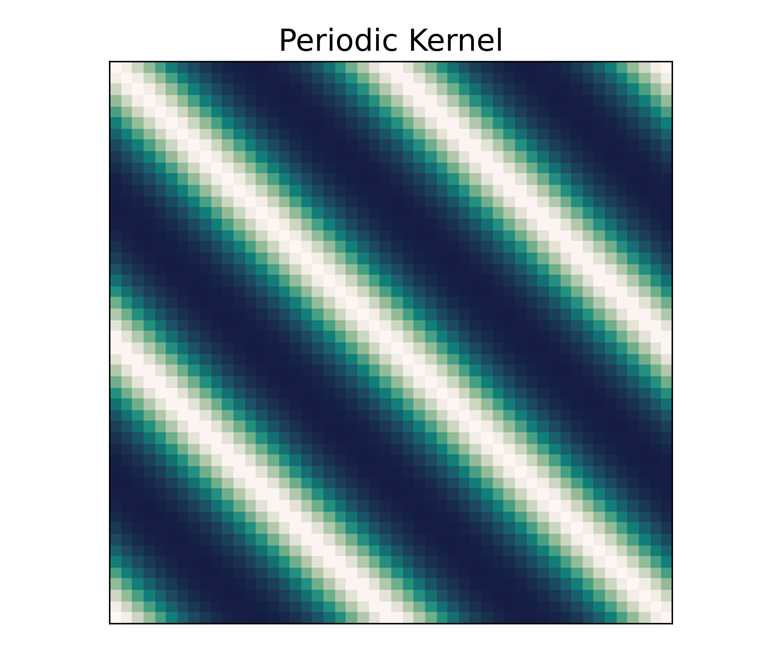
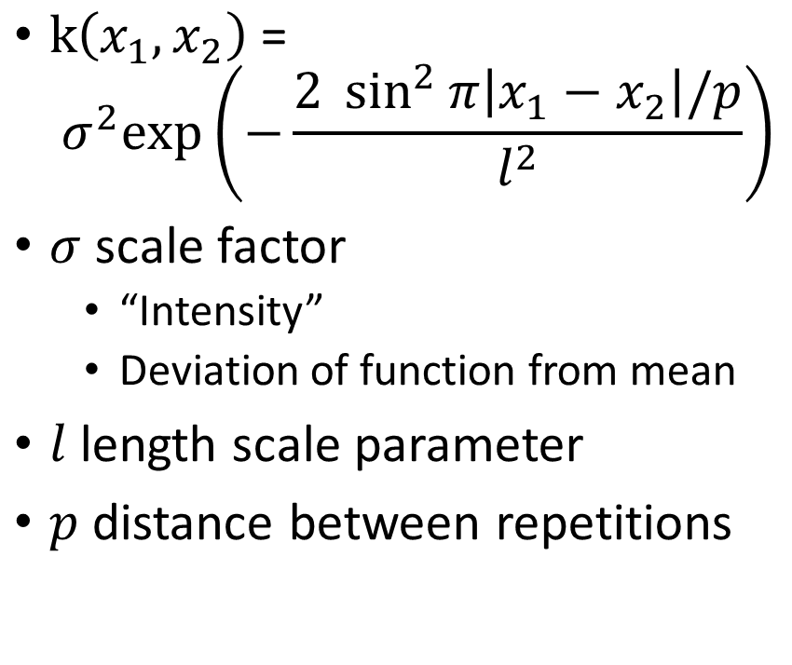
Kernels – Periodic [2]
$\text{k}\left(x_{1},x_{2}\right) \text{=}$ ${ σ}^{2}\text{exp}\left(−\frac{2 \sin^{2}{π\left|x_{1}−x_{2}\right|/p}}{l^{2}}\right)$
$σ$ scale factor
“Intensity”
Deviation of function from mean
$l$ length scale parameter
$p$ distance between repetitions

Slide 12
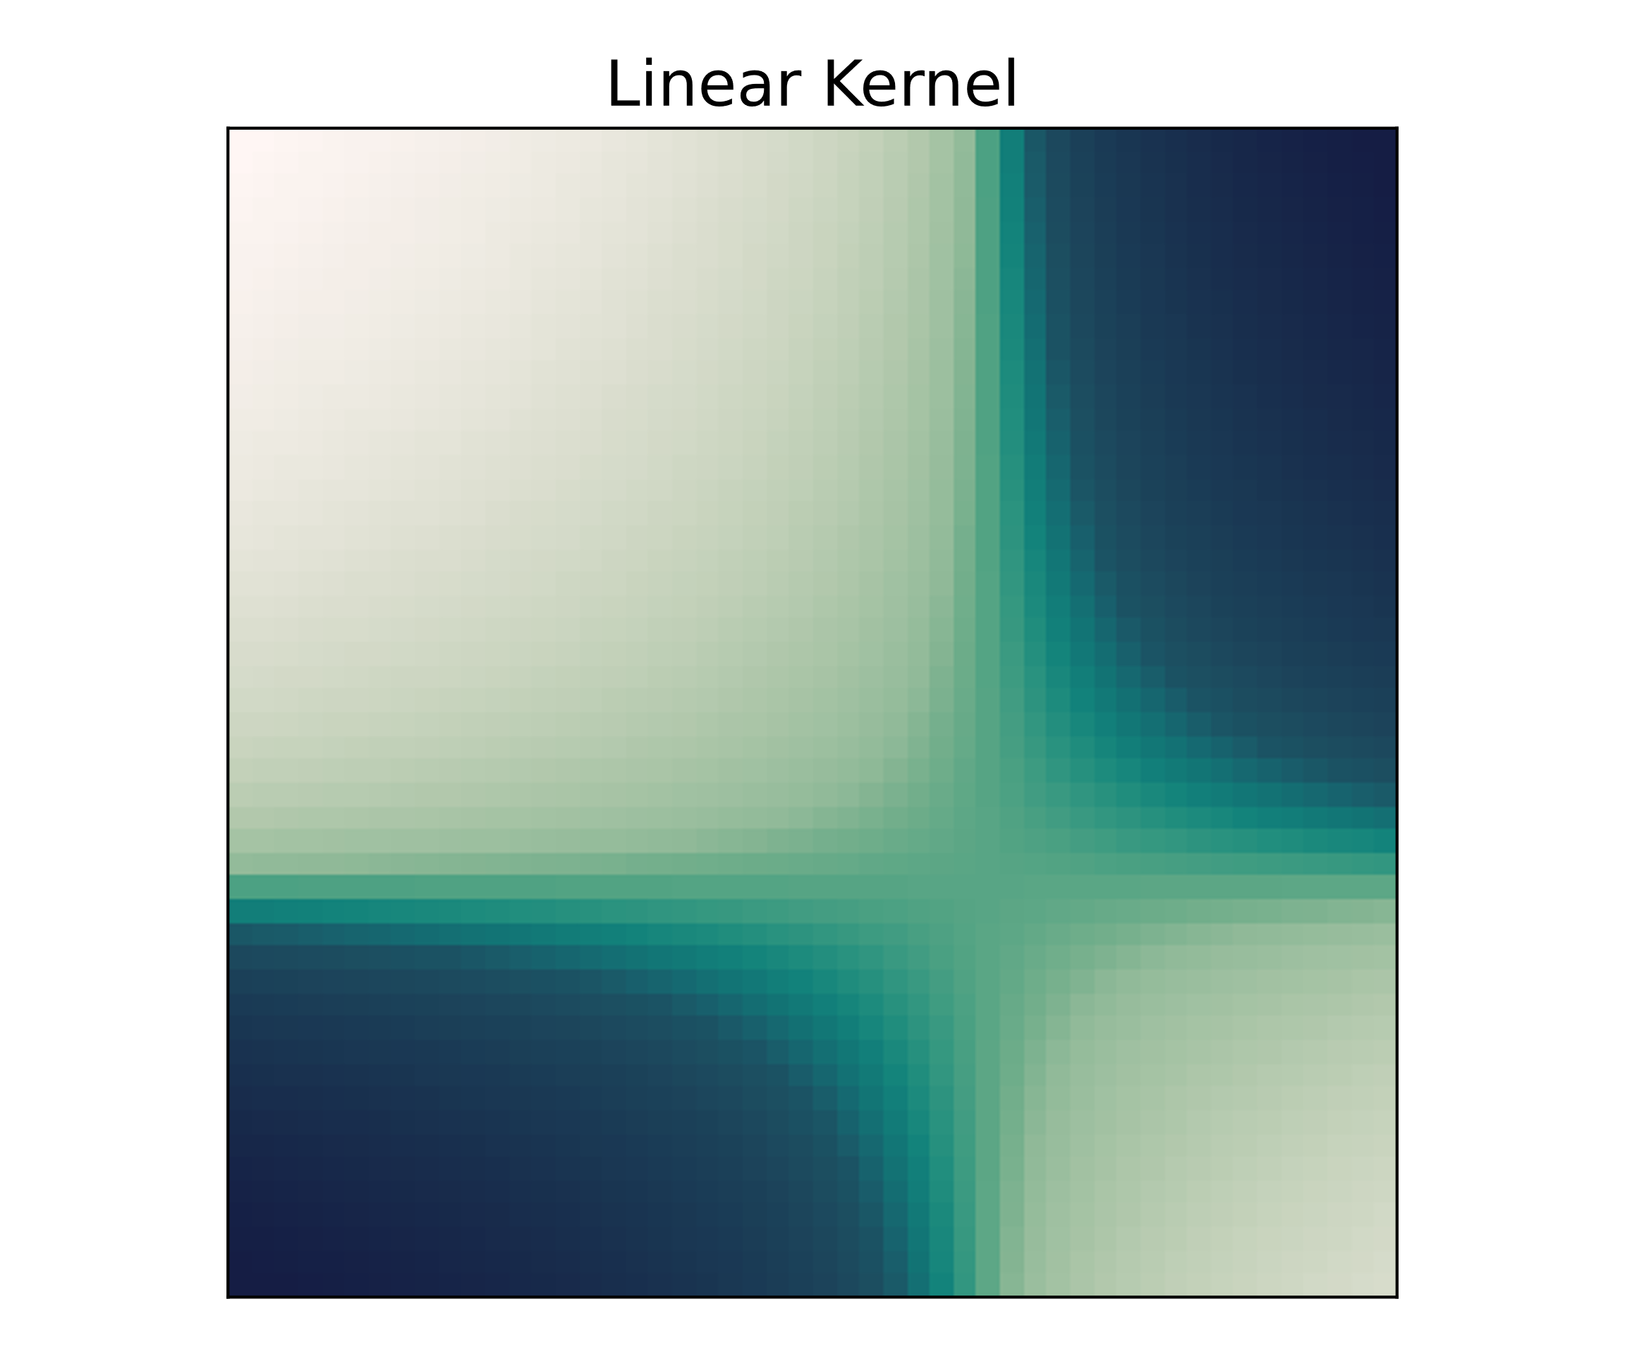
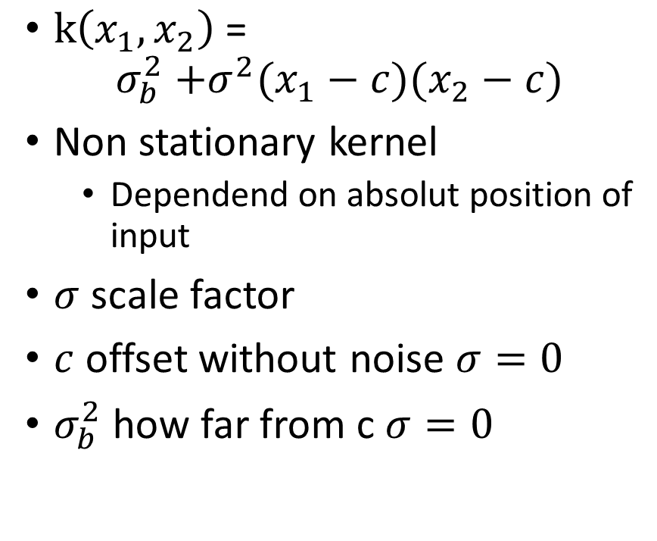
Kernels – Linear [2,3]
$\text{k}\left(x_{1},x_{2}\right) \text{=}$ $σ_{b}^{2}\text{ +}σ^{2}(x_{1}−c)(x_{2}−c)$
Non stationary kernel
Dependend on absolut position of input
$σ$ scale factor
$c$ offset without noise $σ=0$
$σ_{b}^{2}$ how far from c $σ=0$

Slide 13
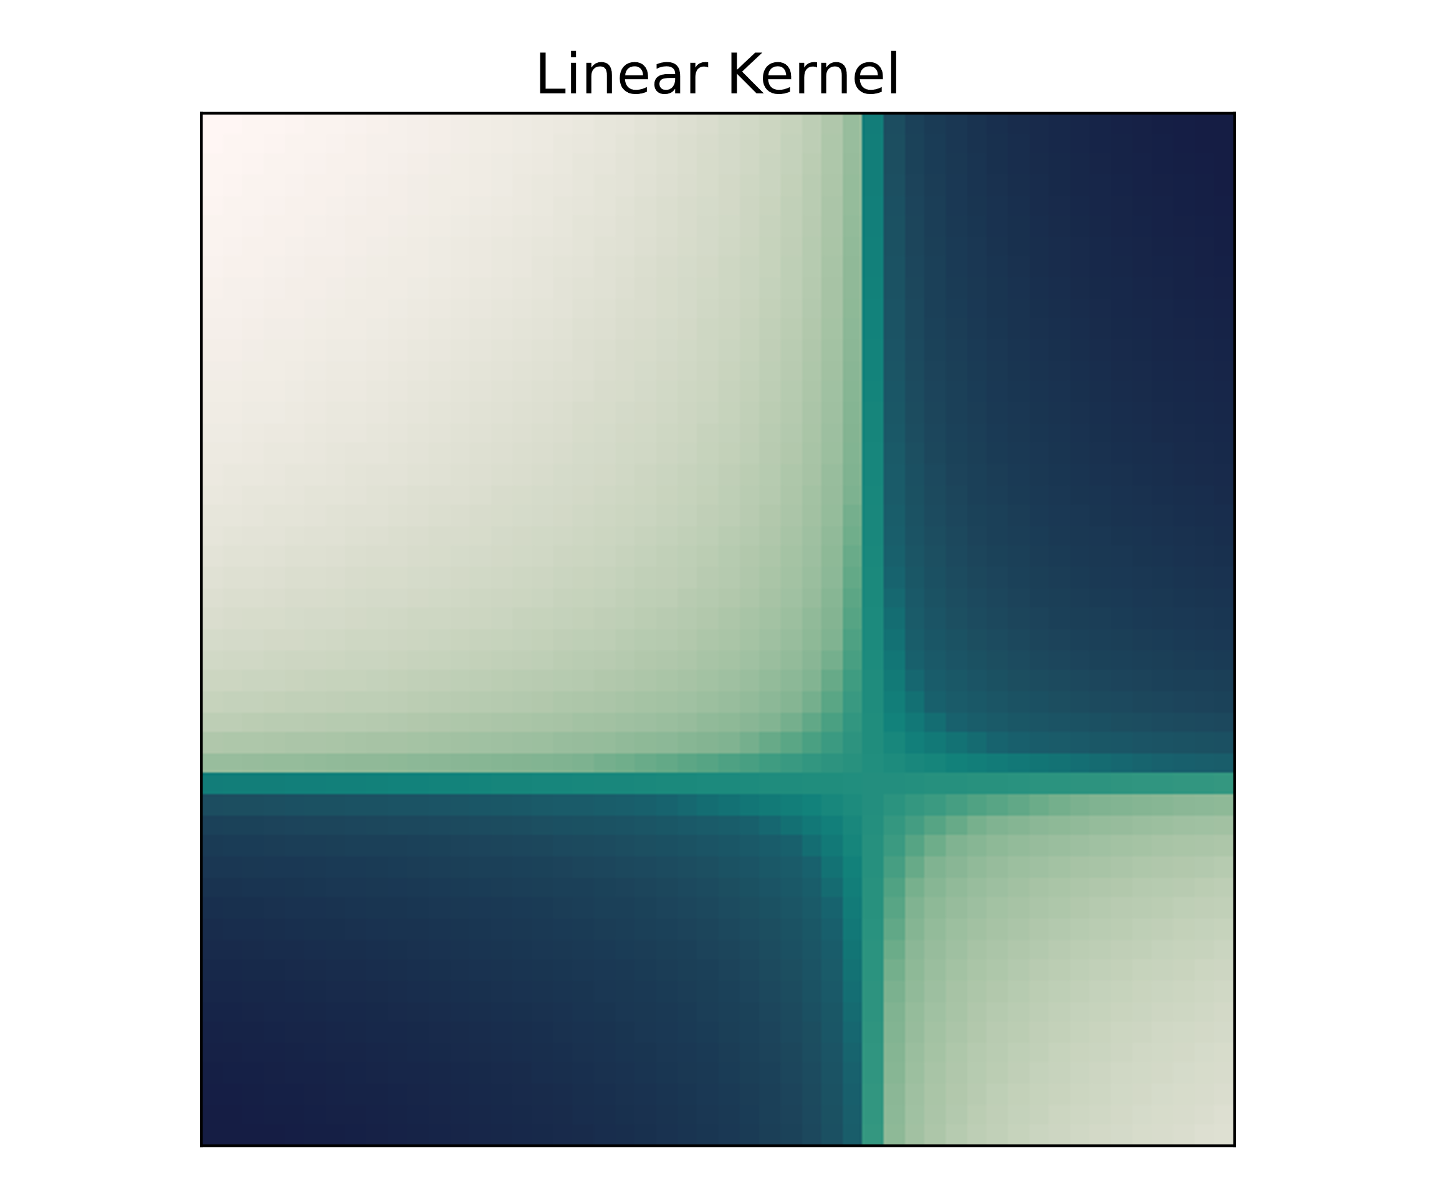
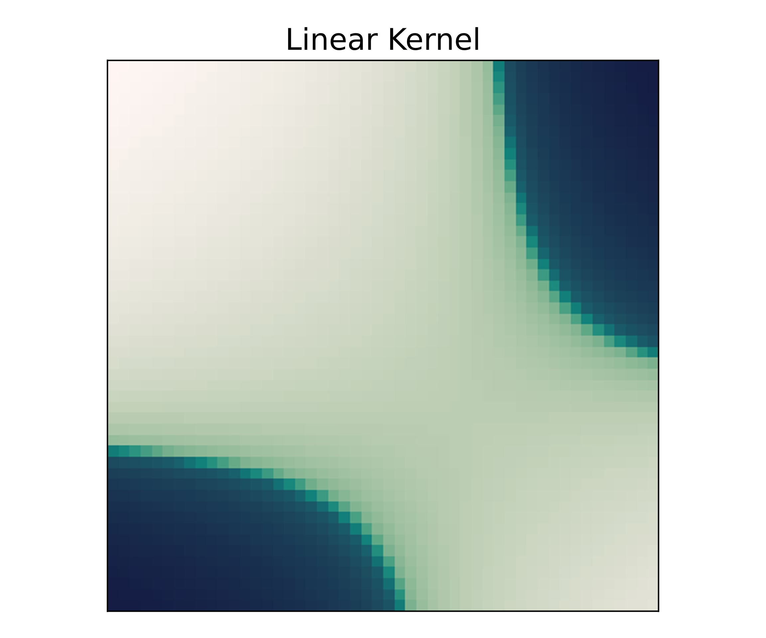


Kernels – Linear
$$σ_{b}=0, c=3,σ=1$$
$$σ_{b}=4, c=3,σ=1$$

Slide 14
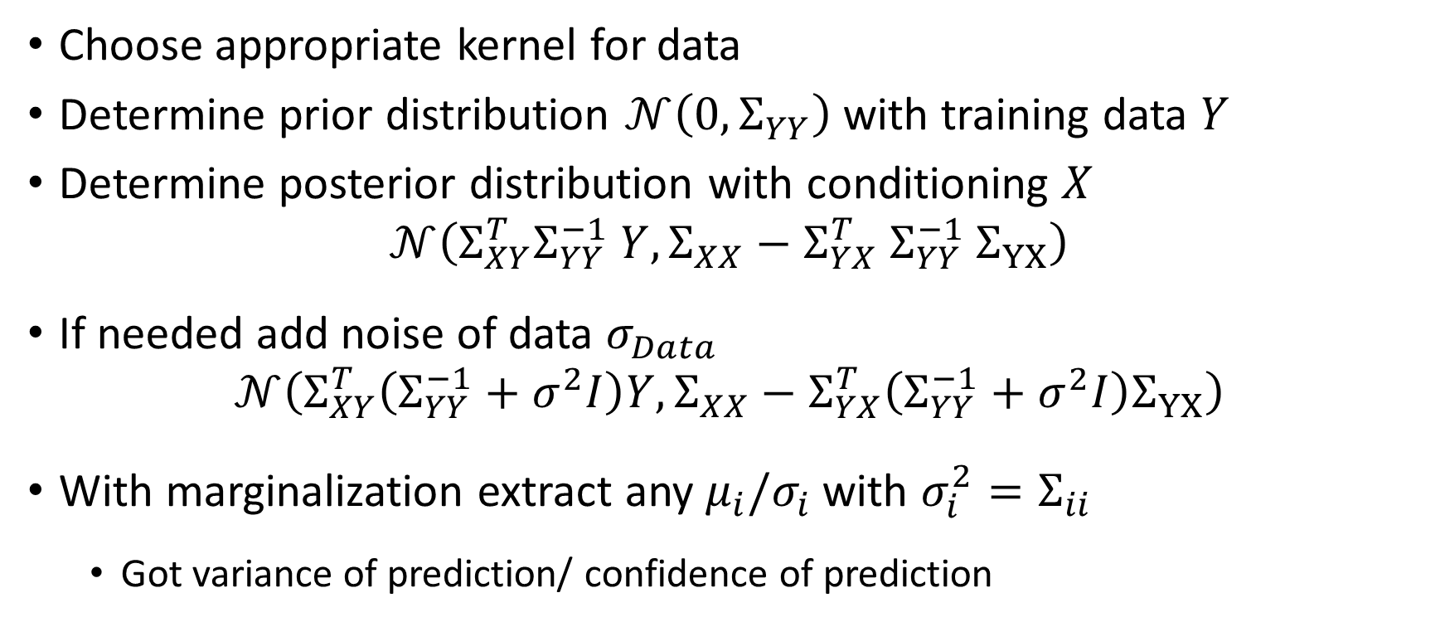
Regression as GP recipe [1,2]
Choose appropriate kernel for data
Determine prior distribution $𝒩\left(0, Σ_{YY}\right)$ with training data $Y$
Determine posterior distribution with conditioning $X$
$$𝒩\left(Σ_{XY}^{T}Σ_{YY}^{−1} Y, Σ_{XX}−Σ_{YX}^{T} Σ_{YY}^{−1} Σ_{YX}\right)$$
If needed add noise of data $σ_{Data}$
$$𝒩\left(Σ_{XY}^{T}\left(Σ_{YY}^{−1}+σ^{2}I\right)Y, Σ_{XX}−Σ_{YX}^{T}\left(Σ_{YY}^{−1}+σ^{2}I\right)Σ_{YX}\right)$$
With marginalization extract any $μ_{i}/σ_{i}$ with $σ_{i}^{2}=Σ_{ii}$
Got variance of prediction/ confidence of prediction

Slide 15
Live coding

Slide 16
Deep Neural Networks as GP [6]
Consider deep fully connected network with independent and identically distributed (i.i.d) random parameters
Final layer sum of i.i.d. terms
Infinit width network
Central limit theorem (CLT)
Computed function drawn from Gaussian distribution
Replace i.i.d prior over weights + biases with GP over functions
Exact bayesian inference
Need to assume central limit theorem holds
Specified GP called Neural Network Gaussian Process – NNGP

Slide 17
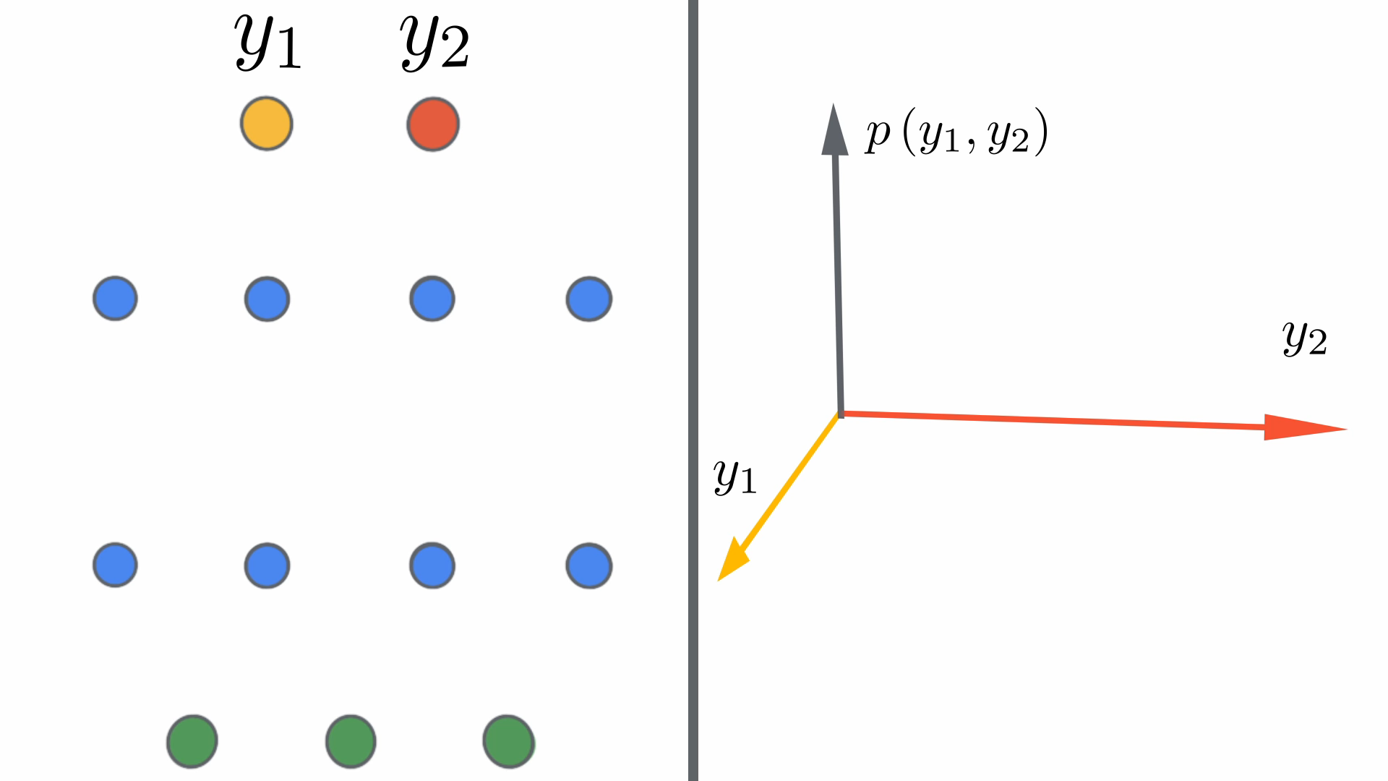
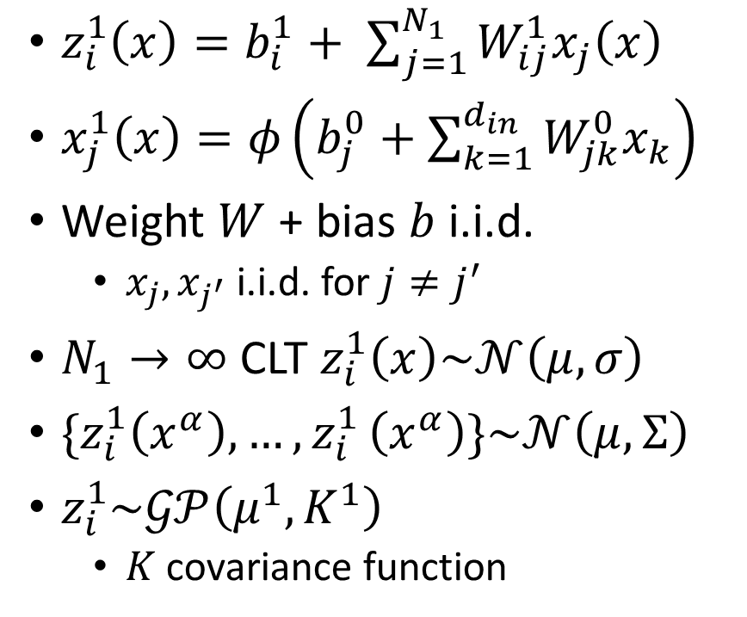
Deep Neural Networks as GP – Single layer[6]
$z_{i}^{1}\left(x\right)=b_{i}^{1}+ \sum_{j=1}^{N_{1}}{W_{ij}^{1}x_{j}\left(x\right)}$
$x_{j}^{1}\left(x\right)=φ\left(b_{j}^{0}+\sum_{k=1}^{d_{in}}{W_{jk}^{0}x_{k}}\right)$
Weight $W$ + bias $b$ i.i.d.
$x_{j},x_{j^{′}}$i.i.d. for $j≠j^{′}$
$N_{1}→∞$ CLT $z_{i}^{1}\left(x\right)\sim 𝒩\left(μ,σ\right)$
$\{z_{i}^{1}\left(x^{α}\right),…{,z}_{i}^{1}\left(x^{α}\right)\}\sim 𝒩\left(μ,Σ\right)$
$z_{i}^{1}\sim 𝒢𝒫\left(μ^{1},K^{1}\right)$
$K$ covariance function
[7]
Notes:
$μ+K$ independent of i

Slide 18
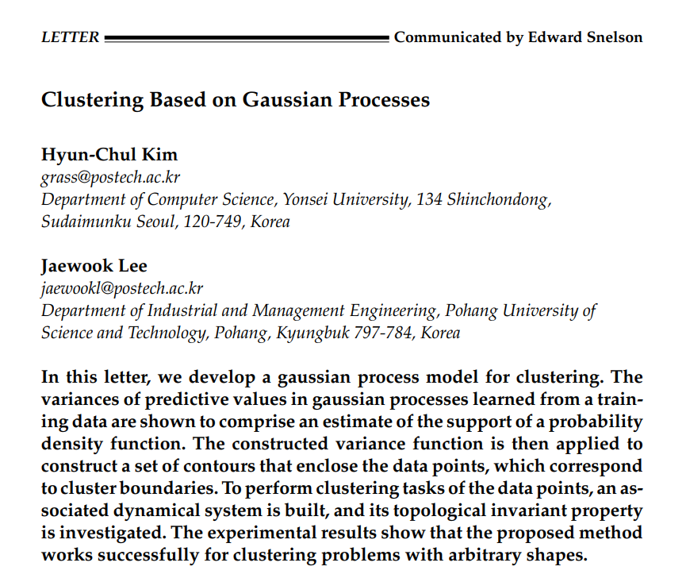

Slide 19
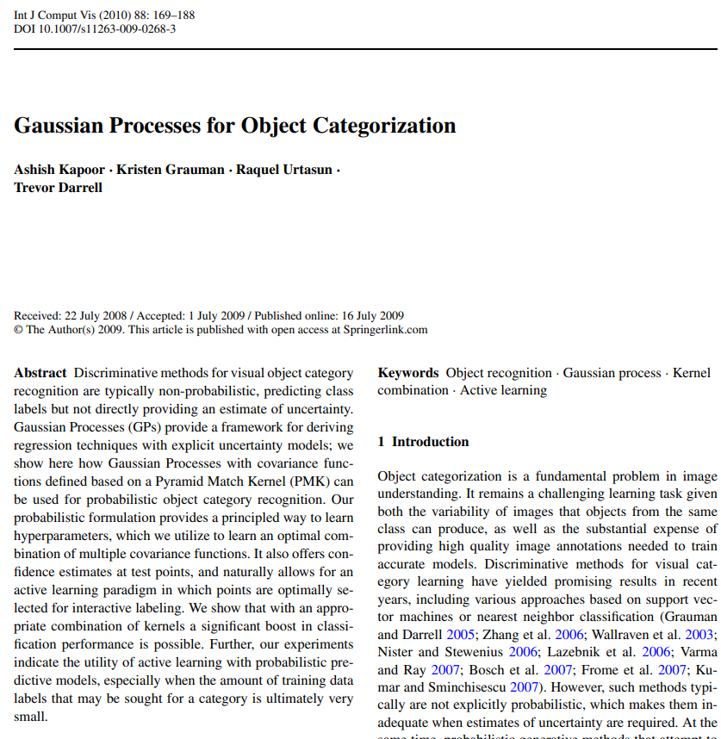

Slide 20
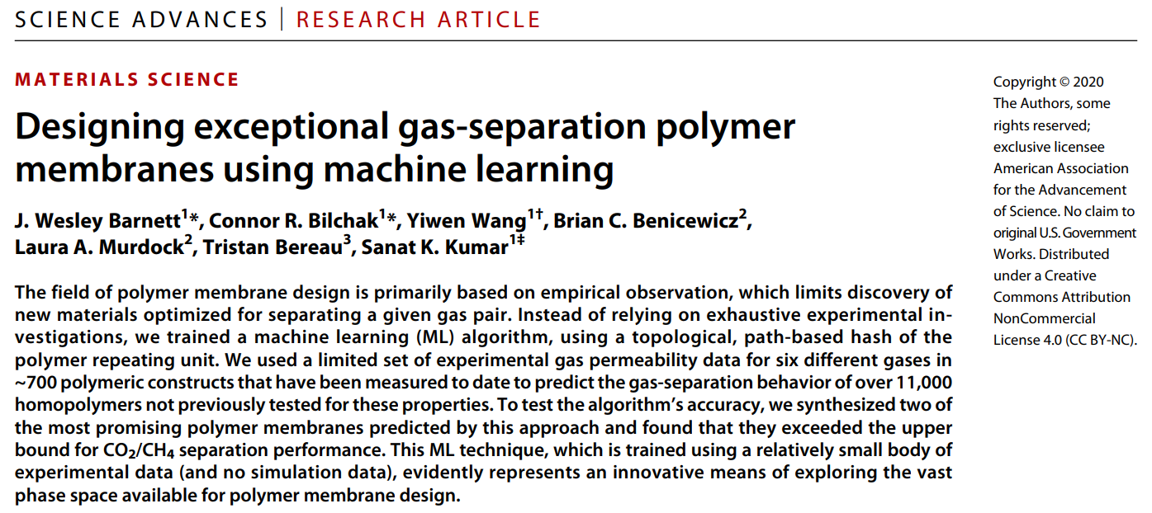

Slide 21
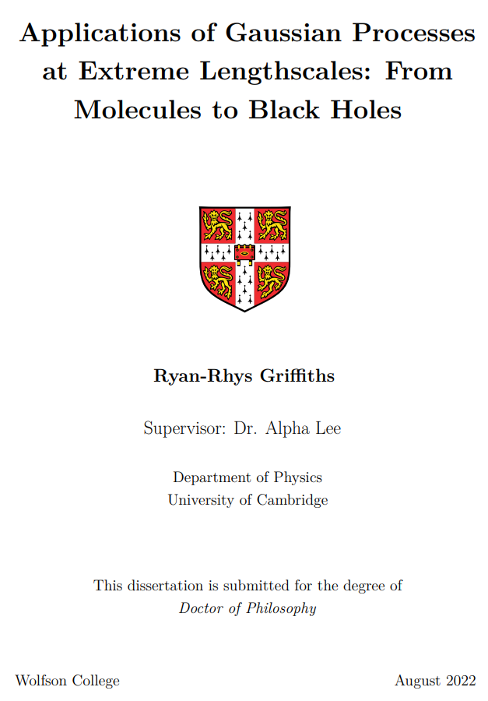
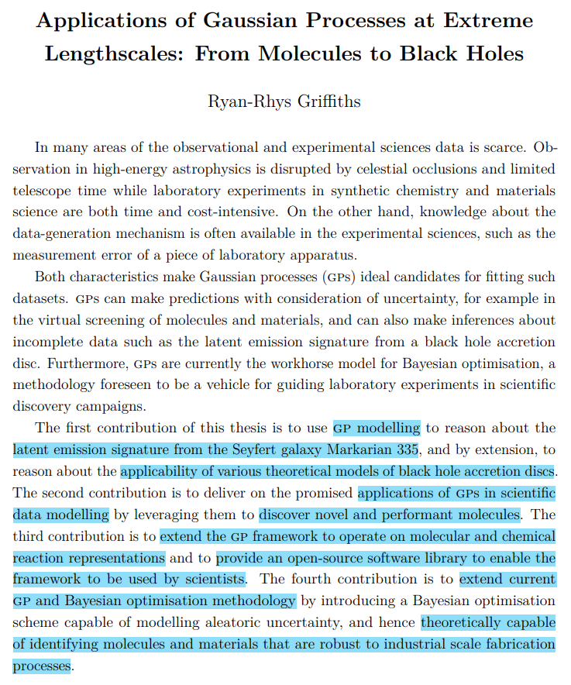

Slide 22
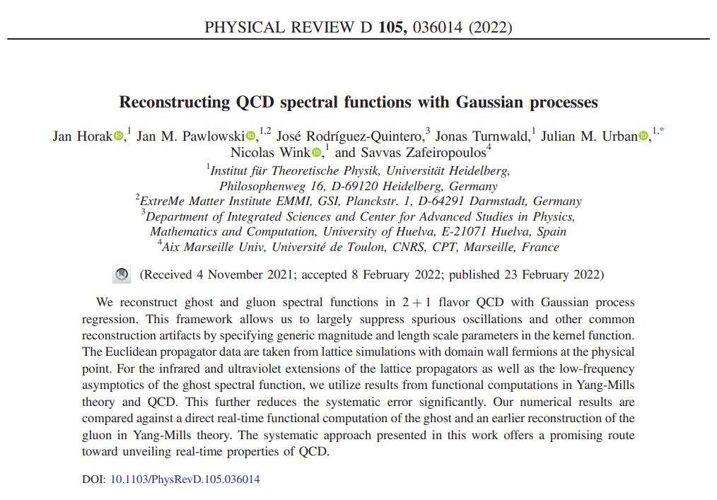

Slide 23
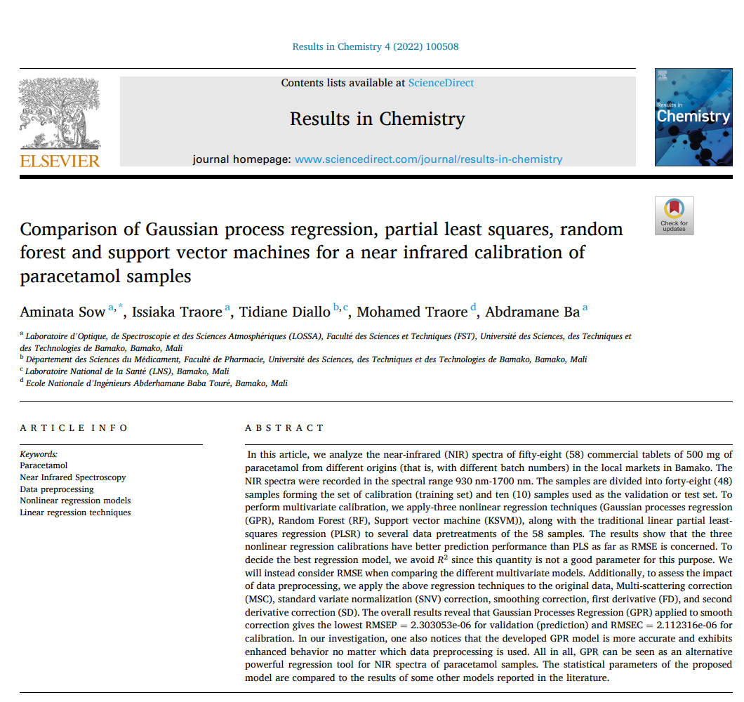

Slide 24
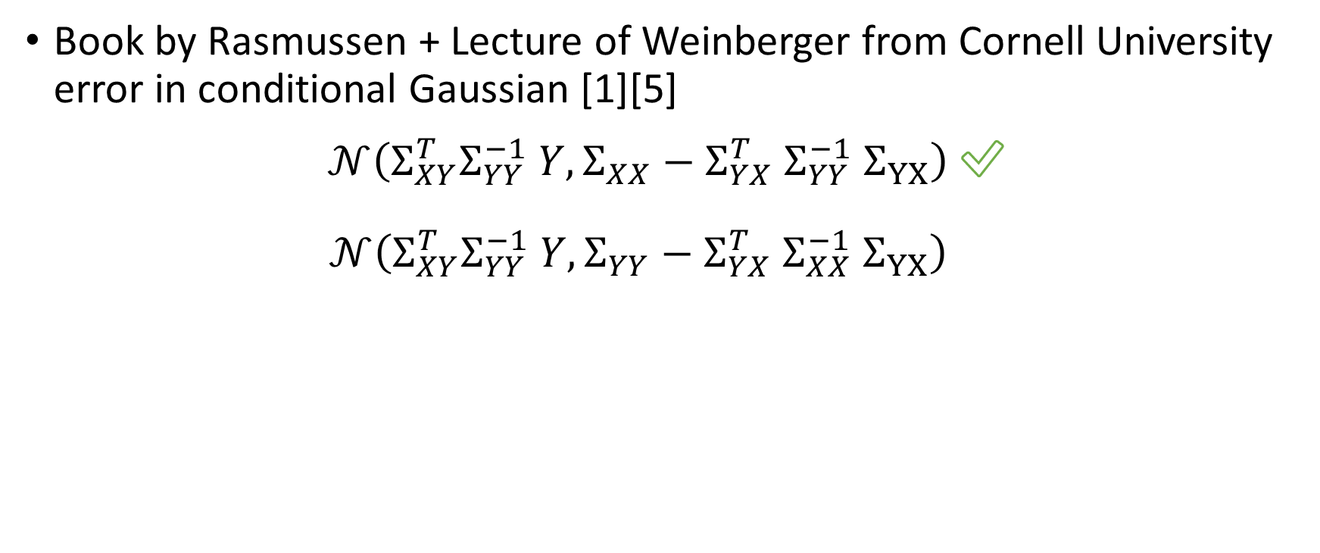
Conclusion - Caveats
Book by Rasmussen + Lecture of Weinberger from Cornell University error in conditional Gaussian [1][5]
$𝒩\left(Σ_{XY}^{T}Σ_{YY}^{−1} Y, Σ_{XX}−Σ_{YX}^{T} Σ_{YY}^{−1} Σ_{YX}\right)$ ✅
$𝒩\left(Σ_{XY}^{T}Σ_{YY}^{−1} Y, Σ_{YY}−Σ_{YX}^{T} Σ_{XX}^{−1} Σ_{YX}\right)$ ✅

Slide 25
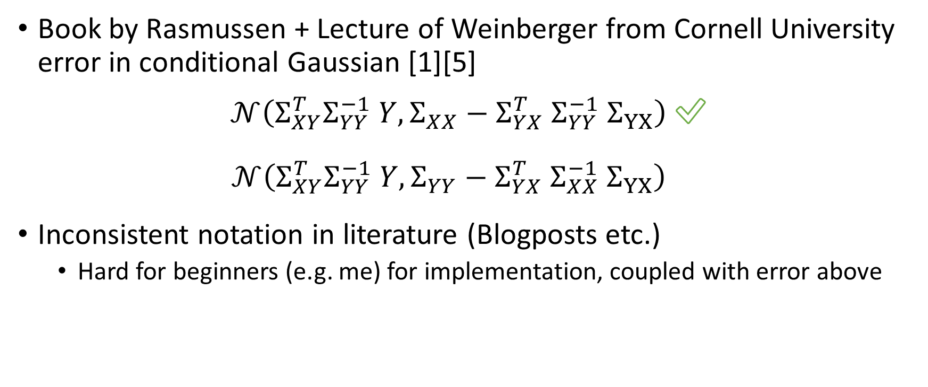
Conclusion - Caveats
Book by Rasmussen + Lecture of Weinberger from Cornell University error in conditional Gaussian [1][5]
$𝒩\left(Σ_{XY}^{T}Σ_{YY}^{−1} Y, Σ_{XX}−Σ_{YX}^{T} Σ_{YY}^{−1} Σ_{YX}\right)$ ✅
$𝒩\left(Σ_{XY}^{T}Σ_{YY}^{−1} Y, Σ_{YY}−Σ_{YX}^{T} Σ_{XX}^{−1} Σ_{YX}\right)$ ✅
Inconsistent notation in literature (Blogposts etc.)
Hard for beginners (e.g. me) for implementation, coupled with error above

Slide 26
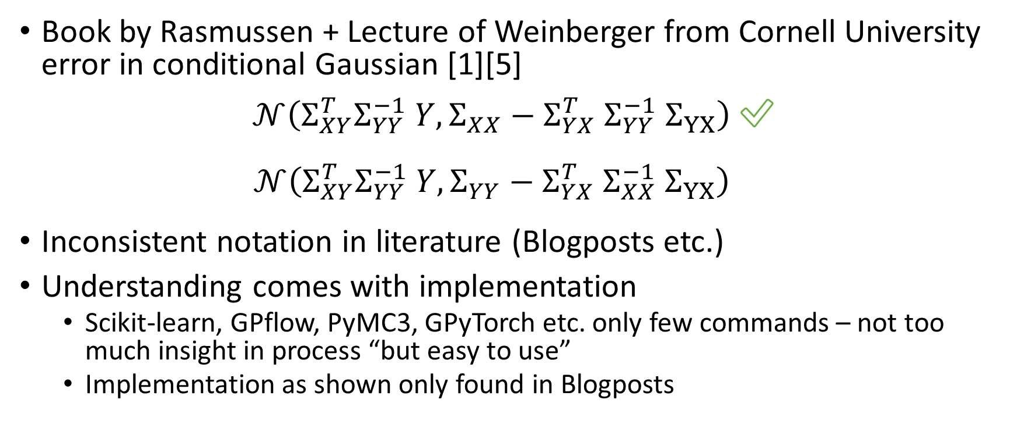
Conclusion - Caveats
Book by Rasmussen + Lecture of Weinberger from Cornell University error in conditional Gaussian [1][5]
$𝒩\left(Σ_{XY}^{T}Σ_{YY}^{−1} Y, Σ_{XX}−Σ_{YX}^{T} Σ_{YY}^{−1} Σ_{YX}\right)$ ✅
$𝒩\left(Σ_{XY}^{T}Σ_{YY}^{−1} Y, Σ_{YY}−Σ_{YX}^{T} Σ_{XX}^{−1} Σ_{YX}\right)$ ✅
Inconsistent notation in literature (Blogposts etc.)
Understanding comes with implementation
Scikit-learn, GPflow, PyMC3, GPyTorch etc. only few commands – not too much insight in process “but easy to use”
Implementation as shown only found in Blogposts

Slide 27
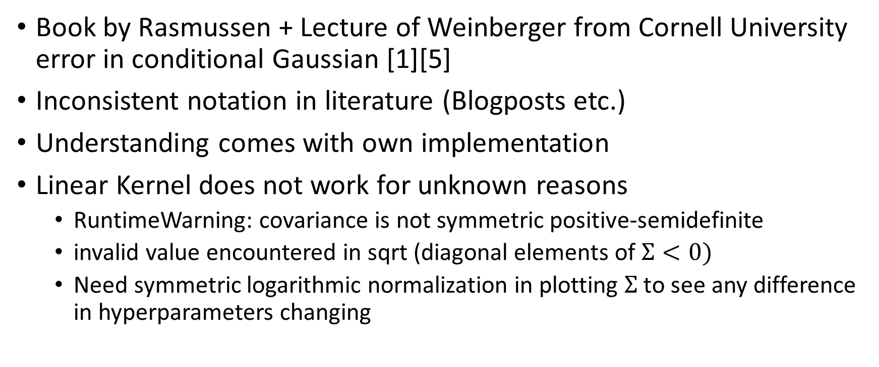
Conclusion - Caveats
Book by Rasmussen + Lecture of Weinberger from Cornell University error in conditional Gaussian [1][5]
Inconsistent notation in literature (Blogposts etc.)
Understanding comes with own implementation
Linear Kernel does not work for unknown reasons
RuntimeWarning: covariance is not symmetric positive-semidefinite
invalid value encountered in sqrt (diagonal elements of $Σ<0)$
Need symmetric logarithmic normalization in plotting $Σ$ to see any difference in hyperparameters changing
Notes:
“If you use just a linear kernel in a GP, you're simply doing Bayesian linear regression, and good news! You can do this in time O(N) instead of O(N3), so you should probably go use software specifically designed for that. “[3]

Slide 28
Conclusion - Caveats
Book by Rasmussen + Lecture of Weinberger from Cornell University error in conditional Gaussian[1][5]
Inconsistent notation in literature (Blogposts etc.)
Understanding comes with own implementation
Linear Kernel does not work for unknown reasons
Concept of test / training data gets smeared due to Bayesian inference

Slide 29
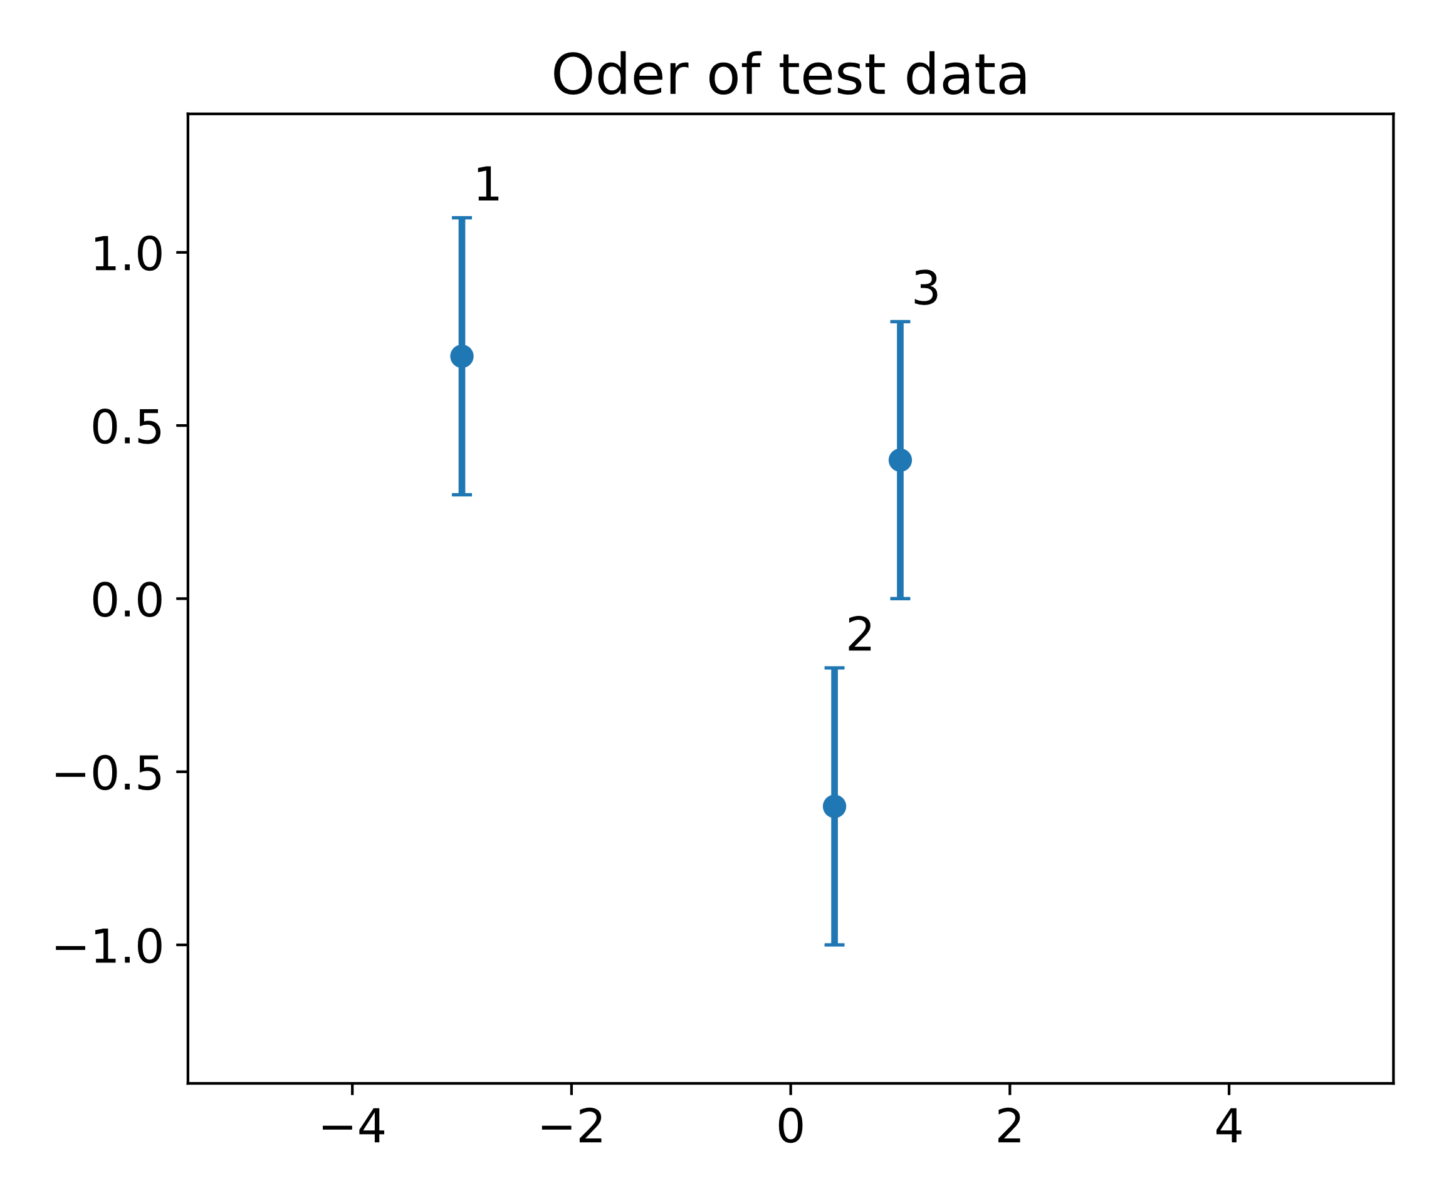
Conclusion – Caveats – Test and Training Data
Concept of test / training data gets smeared
Adding more test data “old” test data gets training data

Slide 30
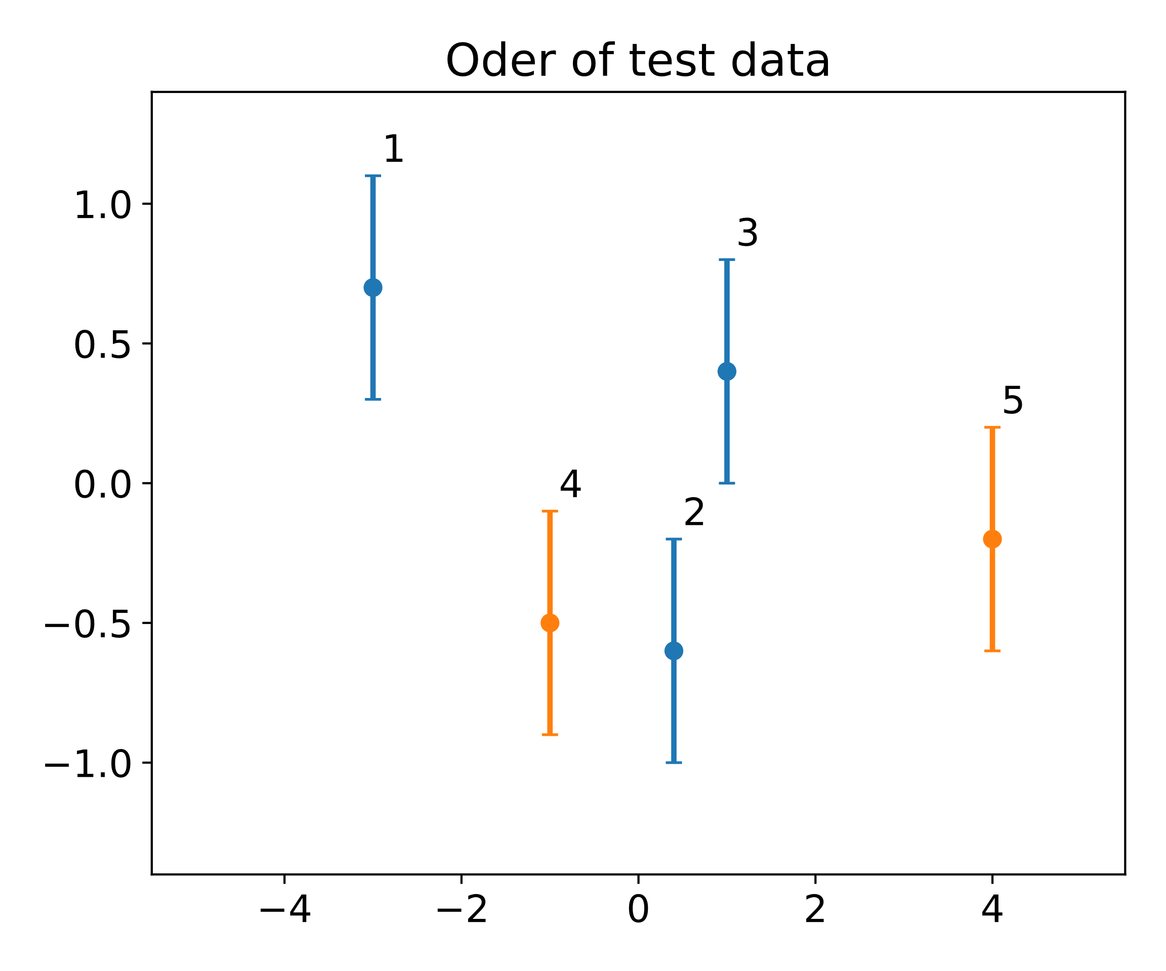
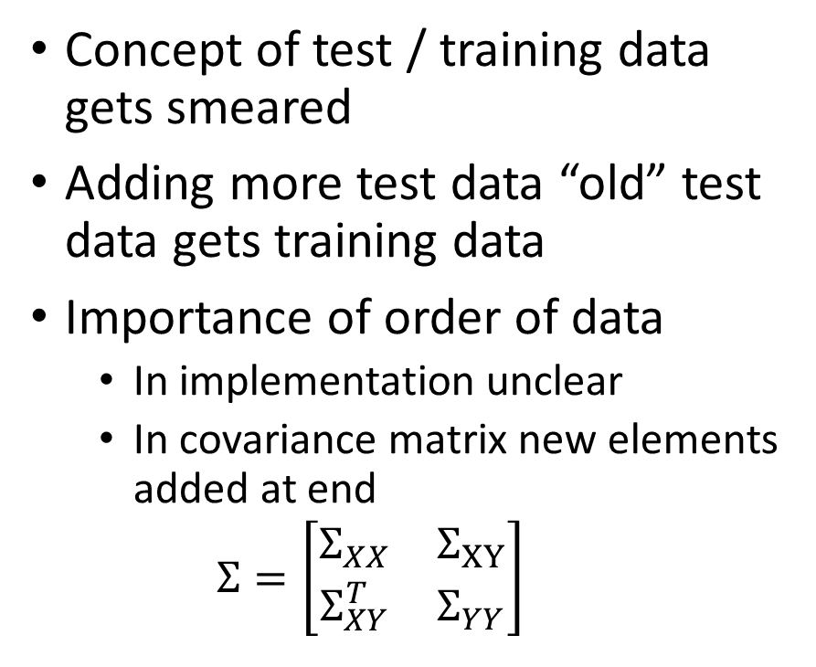
Conclusion – Caveats – Test and Training Data
Concept of test / training data gets smeared
Adding more test data “old” test data gets training data
Importance of order of data
In implementation unclear
In covariance matrix new elements added at end
$$Σ=\left[\begin{matrix}Σ_{XX} & Σ_{XY} \\ Σ_{XY}^{T} & Σ_{YY}\end{matrix}\right]$$

Slide 31
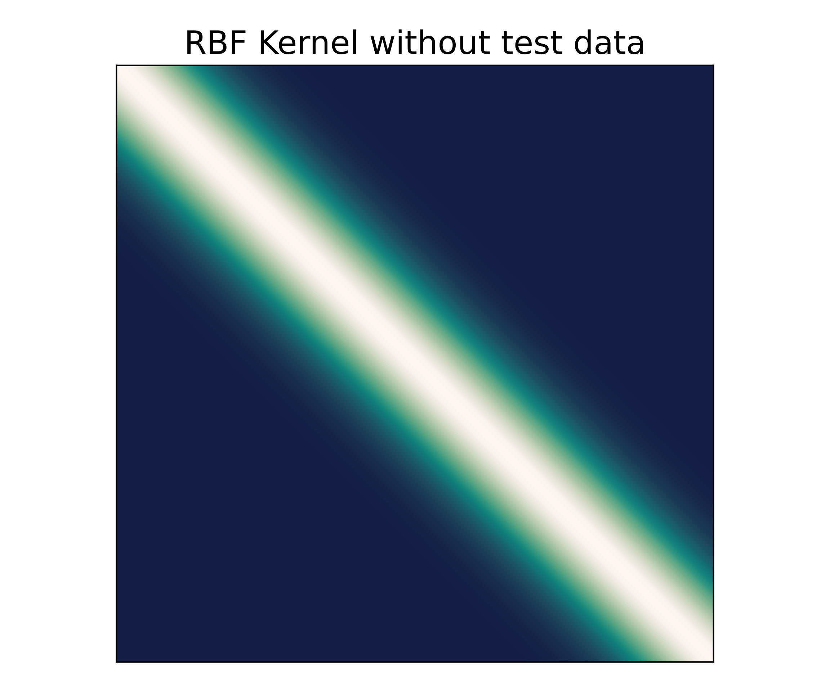
Conclusion – Caveats – Test and Training Data
Concept of test / training data gets smeared
Adding more test data “old” test data gets training data
Importance of order of data
In implementation unclear
In covariance matrix new elements added at end
$$Σ=\left[\begin{matrix}Σ_{XX} & Σ_{XY} \\ Σ_{XY}^{T} & Σ_{YY}\end{matrix}\right]$$

Slide 32
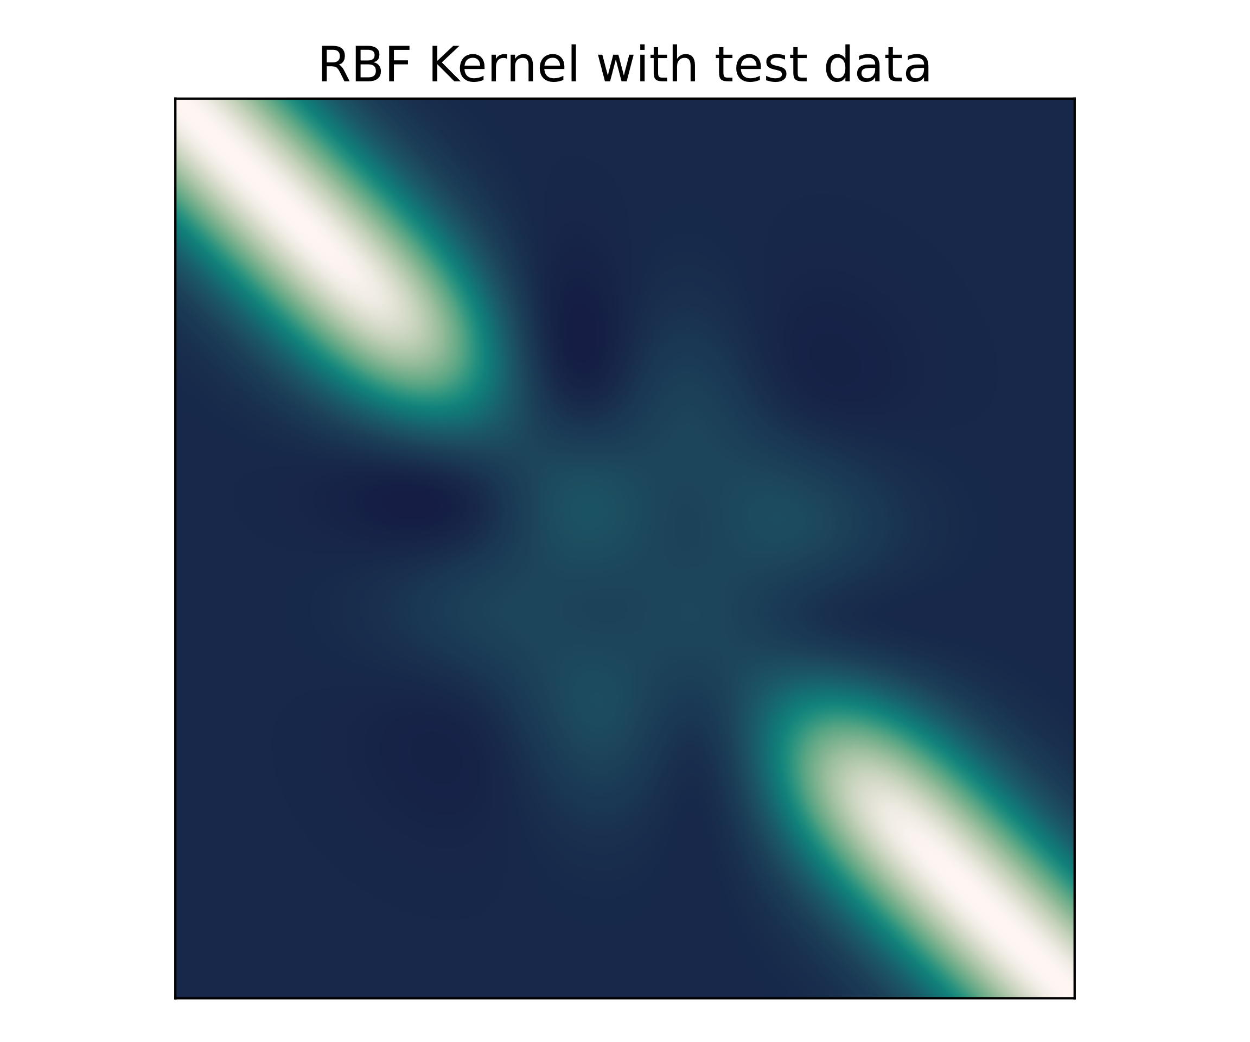
Conclusion – Caveats – Test and Training Data
Concept of test / training data gets smeared
Adding more test data “old” test data gets training data
Importance of order of data
In implementation unclear
In covariance matrix new elements added at end
$$Σ=\left[\begin{matrix}Σ_{XX} & Σ_{XY} \\ Σ_{XY}^{T} & Σ_{YY}\end{matrix}\right]$$

Slide 33
Conclusion - Caveats
Book by Rasmussen + Lecture of Weinberger from Cornell University error in conditional Gaussian [1][5]✅
Inconsistent notation in literature (Blogposts etc.)
Understanding comes with own implementation
Linear Kernel does not work for unknown reasons
Concept of test / training data gets smeared due to Bayesian inference
“Two approaches”
1) Start with x-Axis -> add measurement data -> get predictions from x-Axis
2) Start with measurement -> add x-Axis -> get predictions from x-Axis

Slide 34
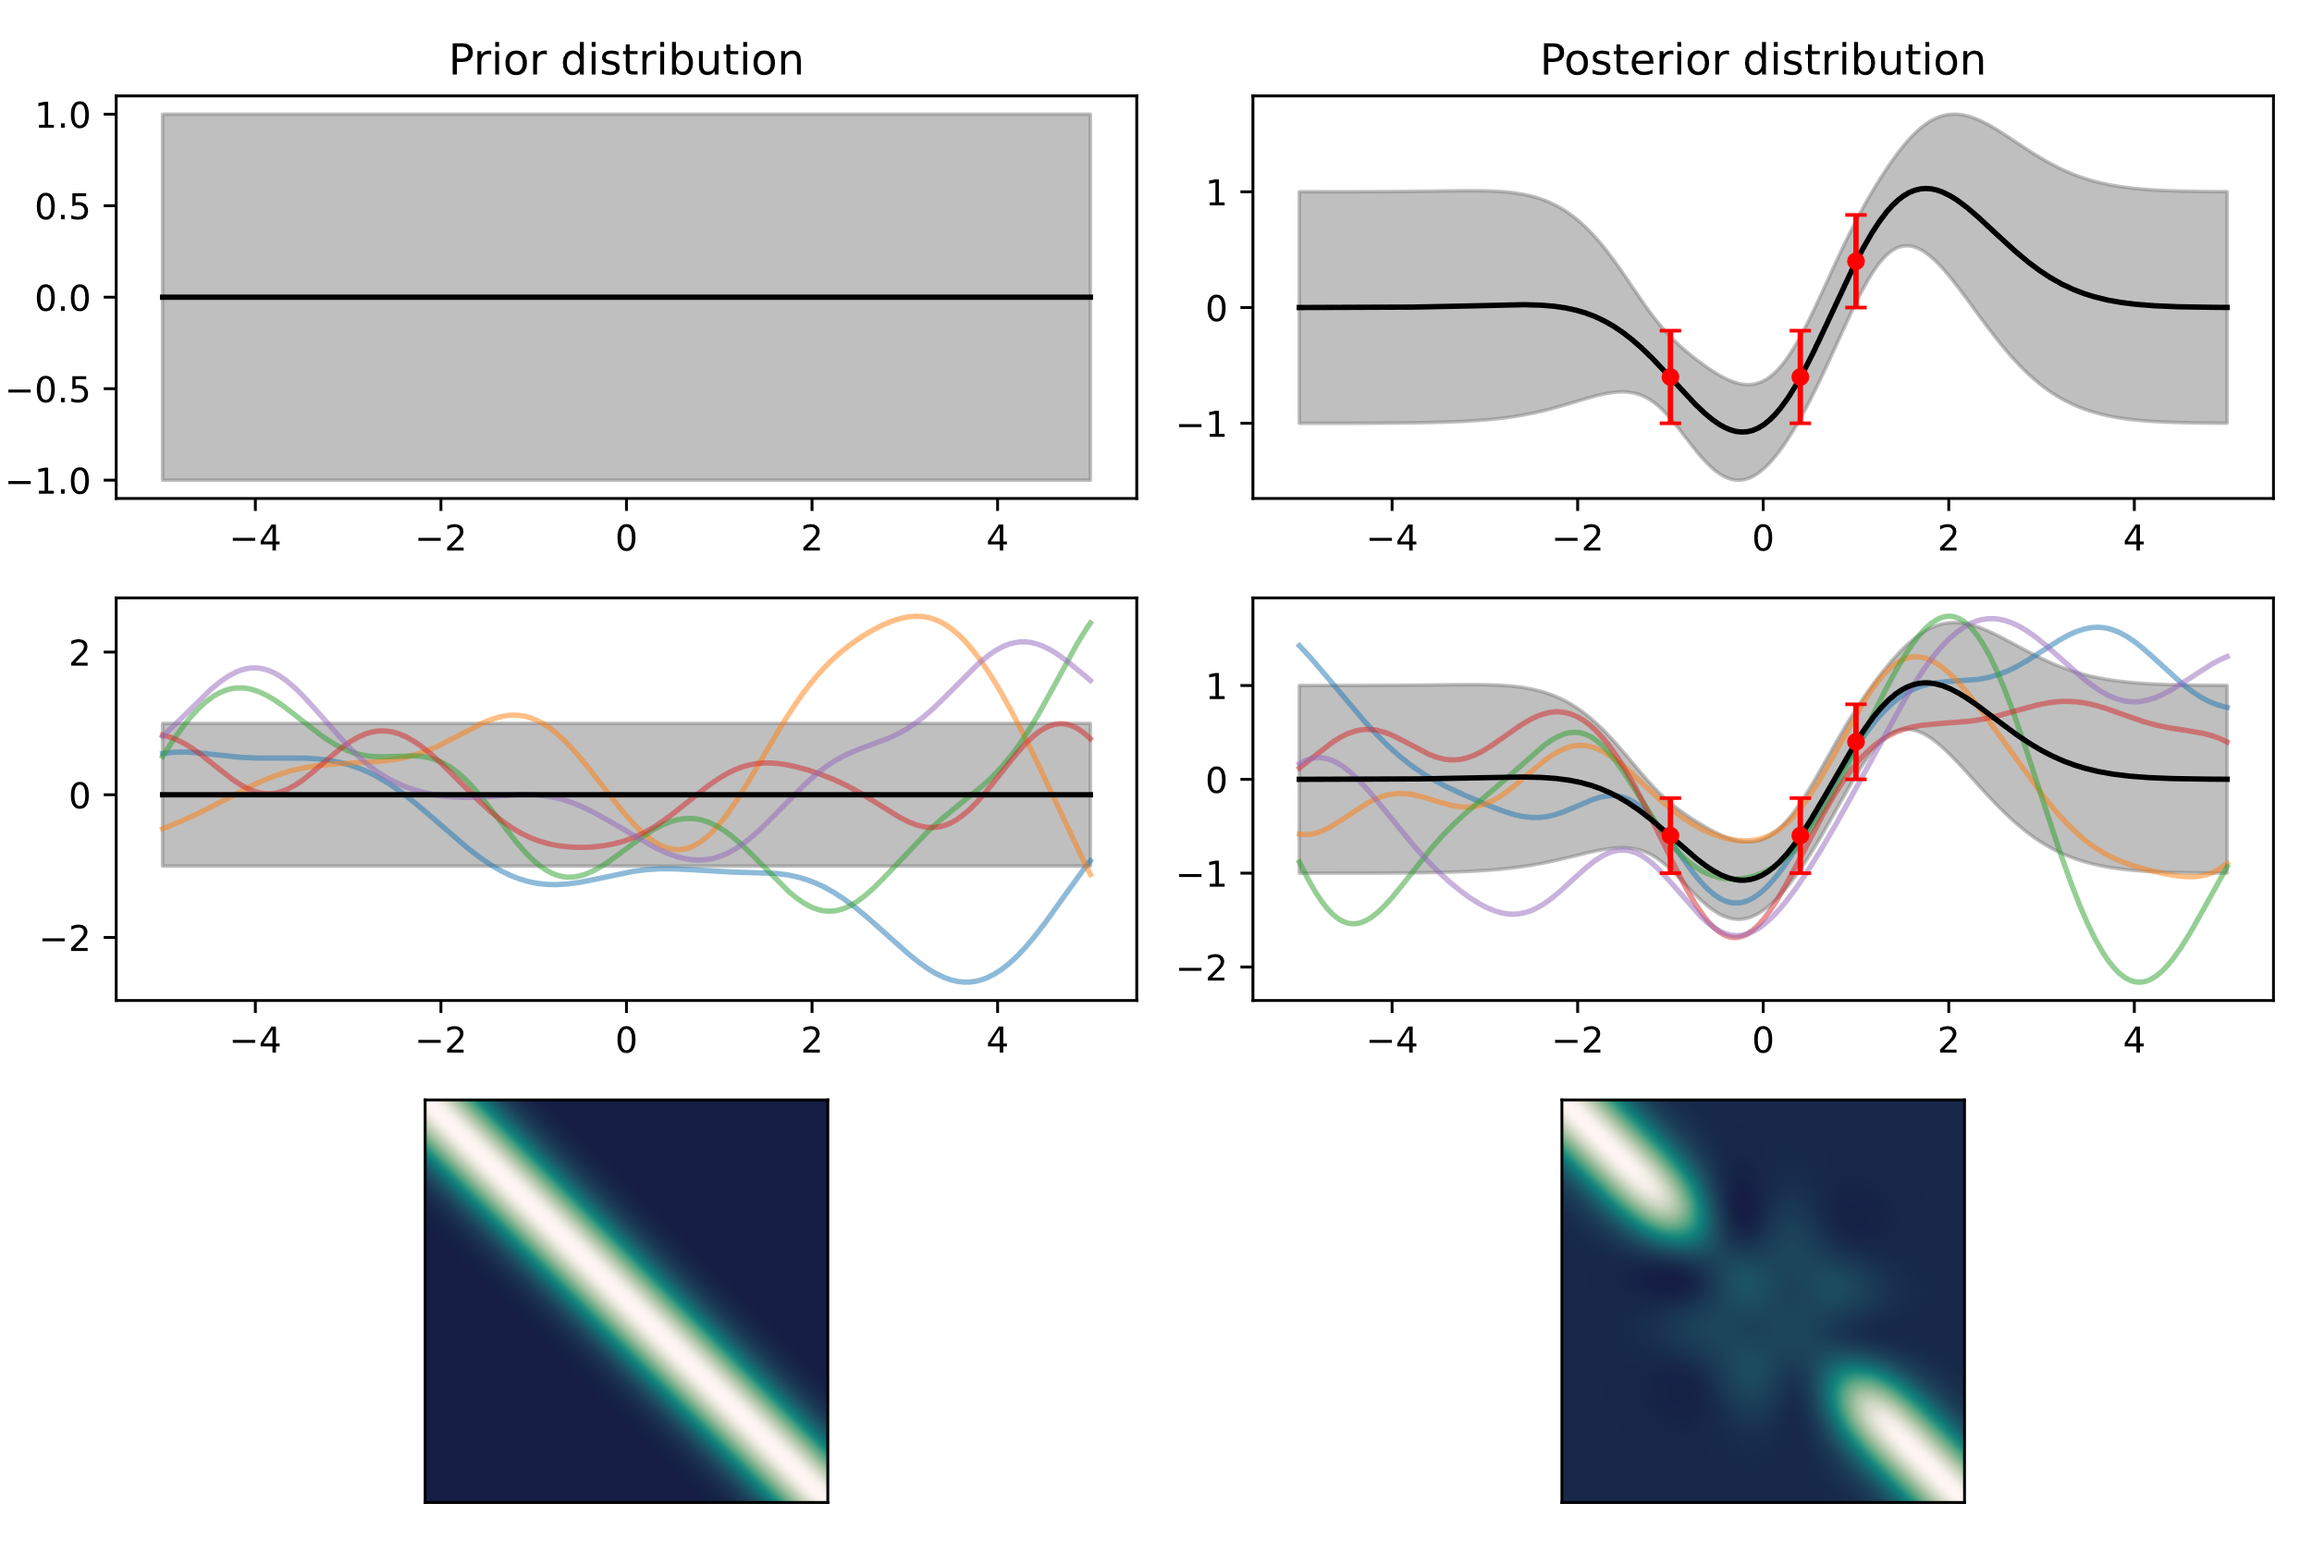
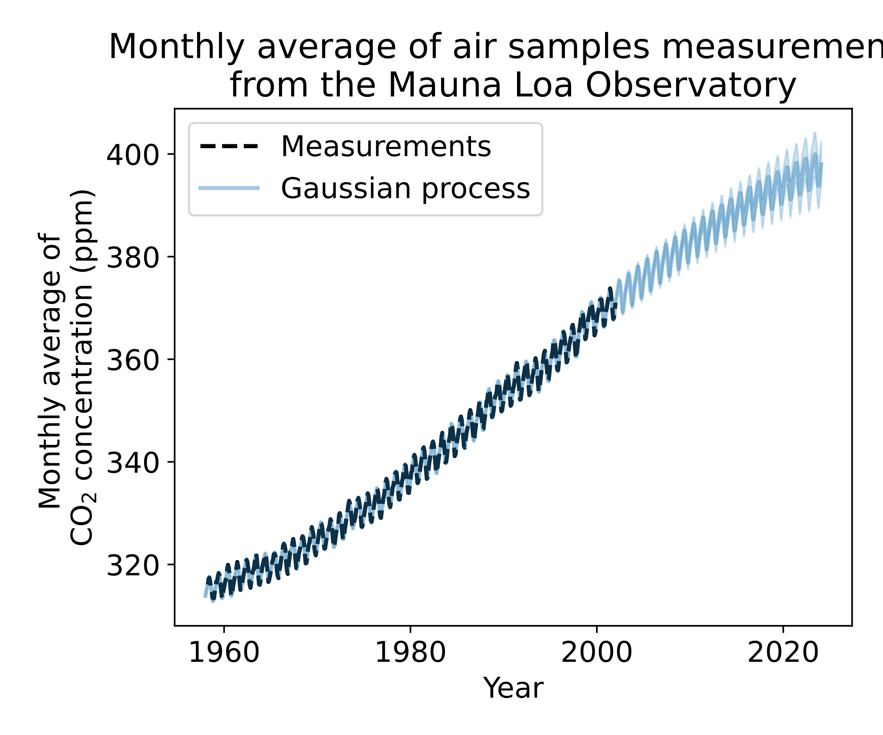
Conclusion – Caveats – “Two approaches”
Approach 1
Approach 2
[4]
Notes:
Approach 1) not totally clear where to implement hyperparameter optimization!
Approach 2) follows more the classical way of fitting data

Slide 35
Conclusion - Caveats
Book by Rasmussen + Lecture of Weinberger from Cornell University error in conditional Gaussian [1][5]✅
Inconsistent notation in literature (Blogposts etc.)
Understanding comes with own implementation
Linear Kernel does not work for unknown reasons
Concept of test / training data gets smeared due to Bayesian inference
“Two approaches”
Hypotheses testing lost?

Slide 36
Conclusion
Conceptionally straightforward
Applications many fields
Lot of different packages for python available
Lot of Caveats – especially in implementation
Inefficient for huge datasets [1]
Hypotheses testing lost?
Kernel choice needs good knowledge of data [3]
Notes:
Huge here not specified

Slide 37
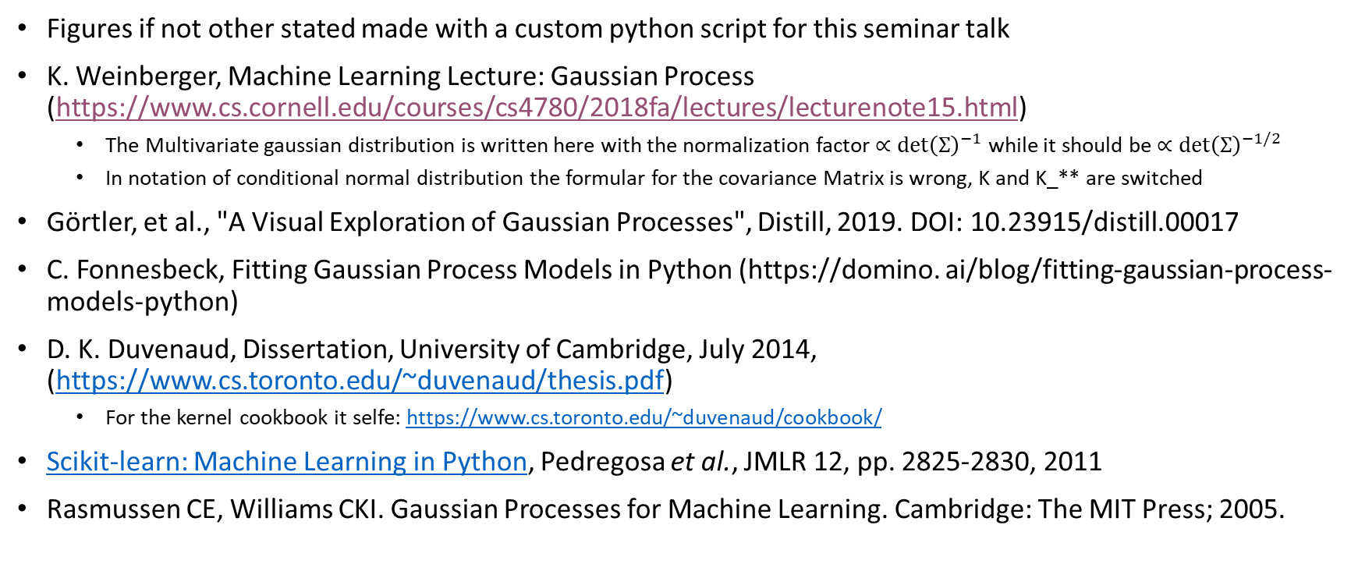
Sources
Figures if not other stated made with a custom python script for this seminar talk
K. Weinberger, Machine Learning Lecture: Gaussian Process (https://www.cs.cornell.edu/courses/cs4780/2018fa/lectures/lecturenote15.html)
The Multivariate gaussian distribution is written here with the normalization factor $∝\det{{\left(Σ\right)}^{−1}}$ while it should be $∝\det{{\left(Σ\right)}^{−1/2}}$
In notation of conditional normal distribution the formular for the covariance Matrix is wrong, K and K_** are switched
Görtler, et al., "A Visual Exploration of Gaussian Processes", Distill, 2019. DOI: 10.23915/distill.00017
C. Fonnesbeck, Fitting Gaussian Process Models in Python (https://domino. ai/blog/fitting-gaussian-process-models-python)
D. K. Duvenaud, Dissertation, University of Cambridge, July 2014, (https://www.cs.toronto.edu/~duvenaud/thesis.pdf)
For the kernel cookbook it selfe: https://www.cs.toronto.edu/~duvenaud/cookbook/
Scikit-learn: Machine Learning in Python, Pedregosa et al., JMLR 12, pp. 2825-2830, 2011
Rasmussen CE, Williams CKI. Gaussian Processes for Machine Learning. Cambridge: The MIT Press; 2005.

Slide 38
Sources
Lee, Jaehoon; Bahri, Yasaman; Novak, Roman; Schoenholz, Samuel S.; Pennington, Jeffrey; Sohl-Dickstein, Jascha (2017). "Deep Neural Networks as Gaussian Processes". International Conference on Learning Representations. arXiv:1711.00165
Samuel S. Schoenholz, Fast and Easy Infinitely Wide Networks with Neural Tangents https://blog.research.google/2020/03/fast-and-easy-infinitely-wide-networks.html
Kim H-C, Lee J. Clustering Based on Gaussian Processes. Neural computation. 2007;19(11):3088-3107.
Kapoor, A., Grauman, K., Urtasun, R. et al. Gaussian Processes for Object Categorization. Int J Comput Vis 88, 169–188 (2010). https://doi.org/10.1007/s11263-009-0268-3
J. Wesley Barnett et al., Designing exceptional gas-separation polymer membranes using machine learning. Sci. Adv.6,eaaz4301(2020).DOI:10.1126/sciadv.aaz4301
Griffiths, Ryan-Rhys. Applications of Gaussian Processes at Extreme Lengthscales: From Molecules to Black Holes. Apollo - University of Cambridge Repository, 2022, doi:10.17863/CAM.93643.
Horak J, Pawlowski JM, Rodríguez-Quintero J, et al. Reconstructing QCD spectral functions with Gaussian processes. Physical review. 2022;105:1-12. doi:10.1103/PhysRevD.105.036014.
Sow A, Traore I, Diallo T, Traore M, Ba A. Comparison of Gaussian process regression, partial least squares, random forest and support vector machines for a near infrared calibration of paracetamol samples. Results in Chemistry. 2022;4:100508.

